Slide 1
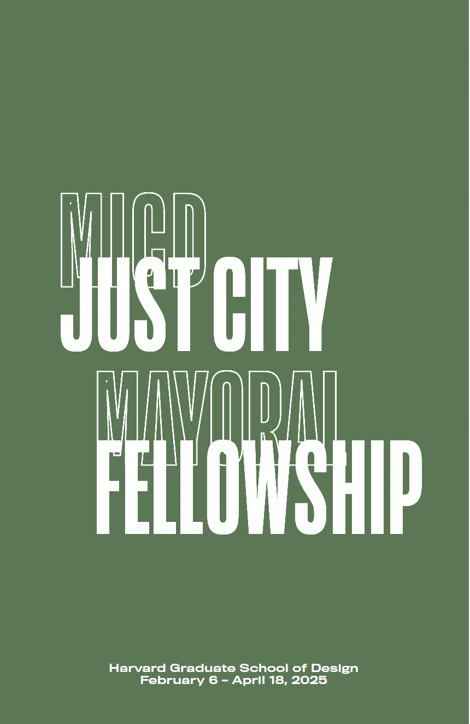
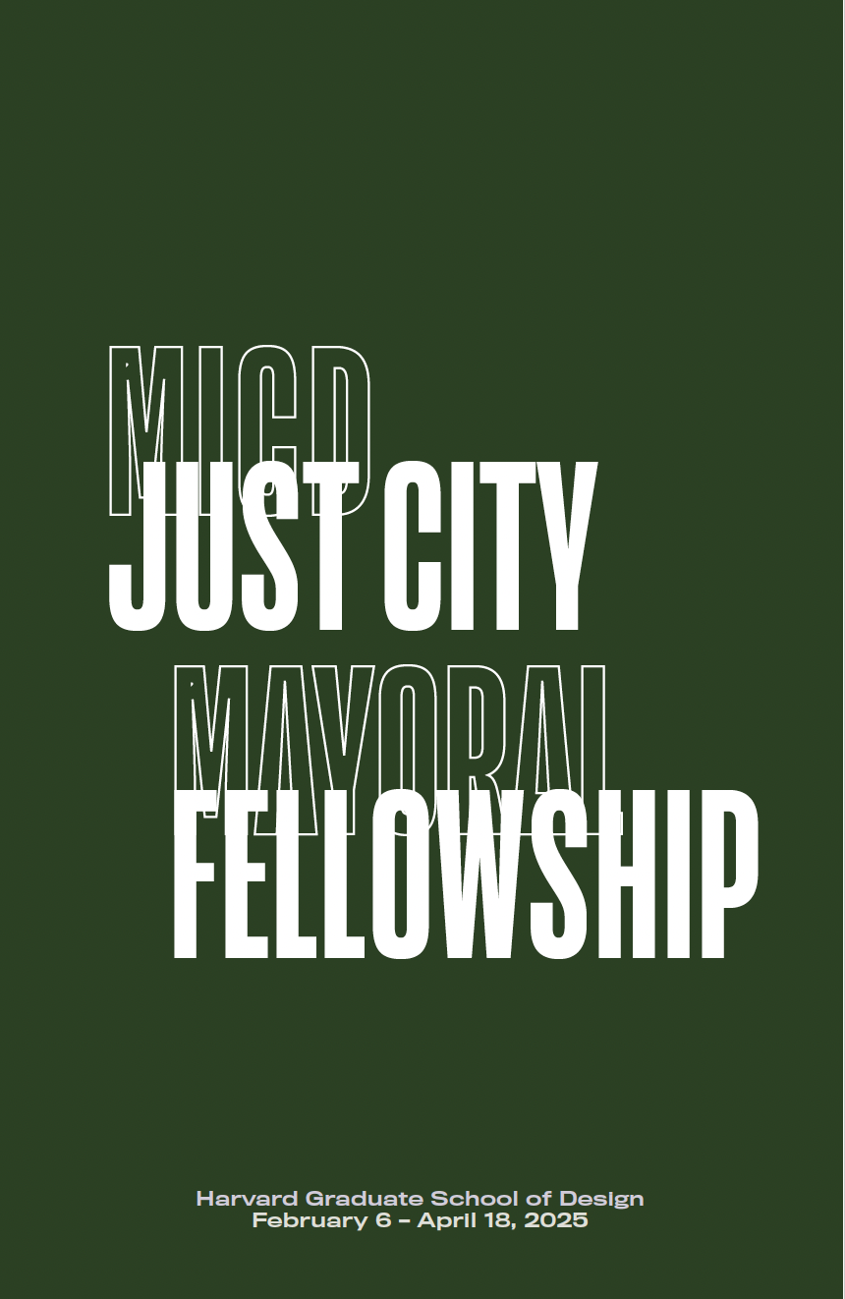

Slide 2
introduction icebreaker #1
Notes:
For many who we seek justice for, their injustice is situated in the spaces of the city. A series of conditions instigated by public policy, advanced by private capital, deepened by generational poverty and disinvestment, and stigmatized by…

Slide 3
what’s in a
name
…your origin story
Notes:
For many who we seek justice for, their injustice is situated in the spaces of the city. A series of conditions instigated by public policy, advanced by private capital, deepened by generational poverty and disinvestment, and stigmatized by…

Slide 4
My name is…..
I am named after…or
My name means….or
My name came about from…
Notes:
For many who we seek justice for, their injustice is situated in the spaces of the city. A series of conditions instigated by public policy, advanced by private capital, deepened by generational poverty and disinvestment, and stigmatized by…

Slide 5
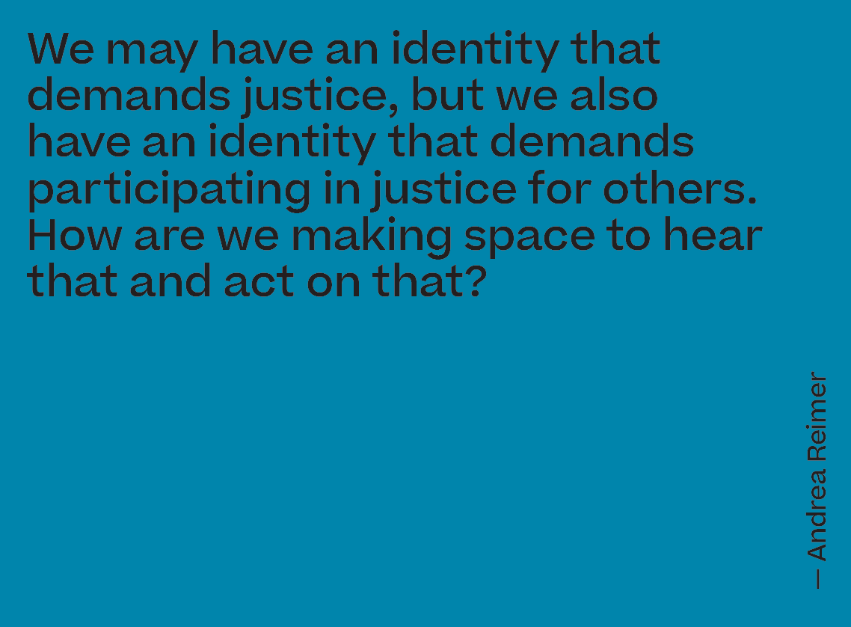

Slide 6
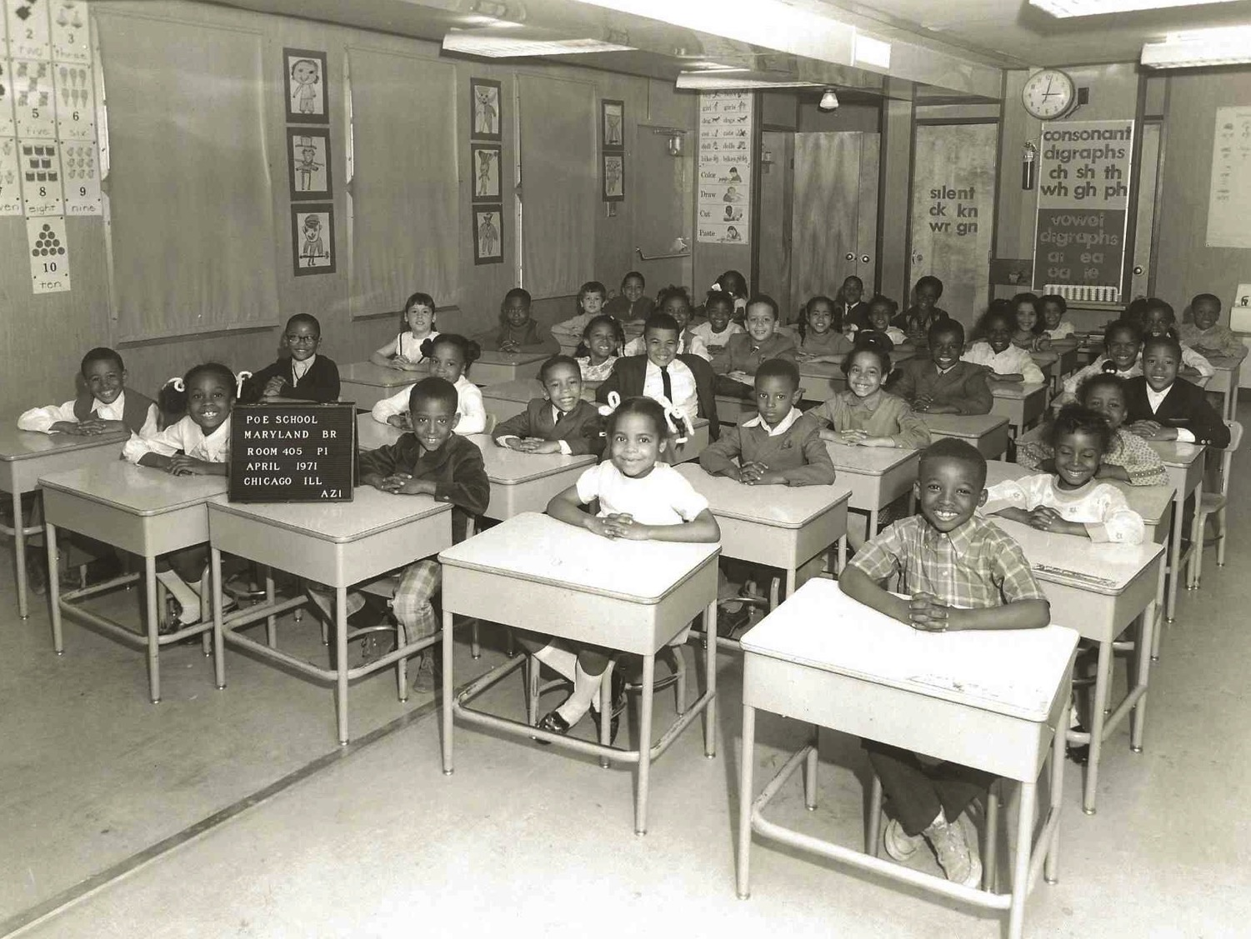
Notes:
I was born in Chicago, the evening before President Lyndon Johnson signed the Civil Rights Act of 1964 into law.
Growing up on the south side of Chicago meant that on an average day, I rarely saw or interacted with a person who didn’t look like me. All of my basic needs were meet on the south side of Chicago - schooling, shopping, summer jobs, recreation and entertainment. My teachers were predominately black, and my classmates were 98% black. This environment did not make me feel isolated, segregated or unusual -- I just felt normal.

Slide 7
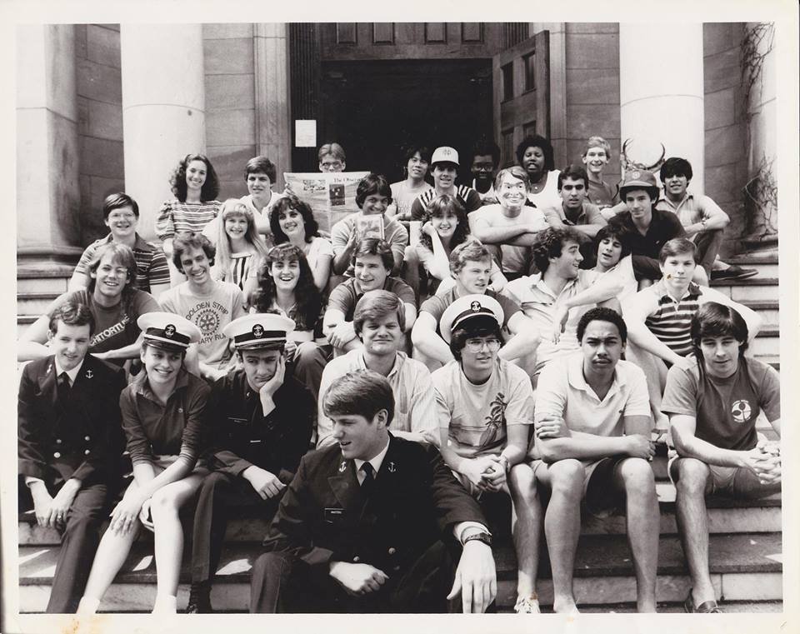
Notes:
By the time I entered college at the University of Notre Dame, and the field of architecture, my context became the exact opposite. For the first time in my life, I actually felt like a minority.

Slide 8
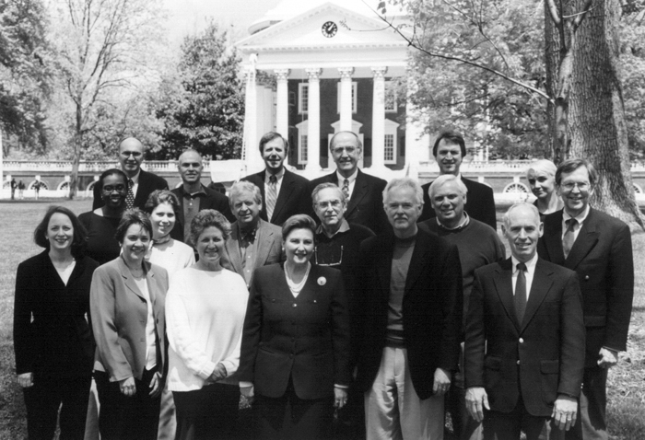
Notes:
And today professionally, I remain a minority in my chose field. I am the only African American full time faculty at the City College of New York School of Architecture, and one of less than 300 African American women to be licensed in the United States.

Slide 9
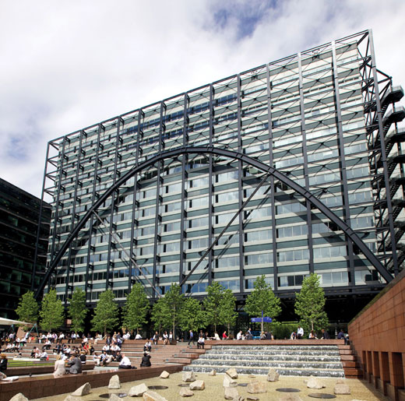

Slide 10
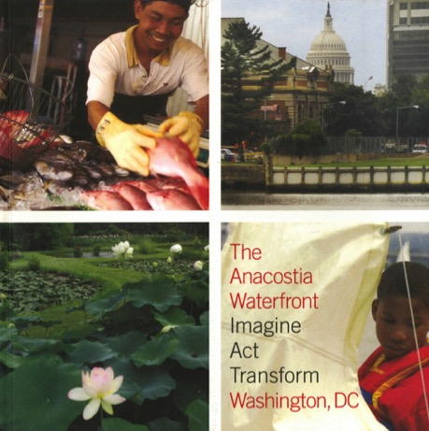
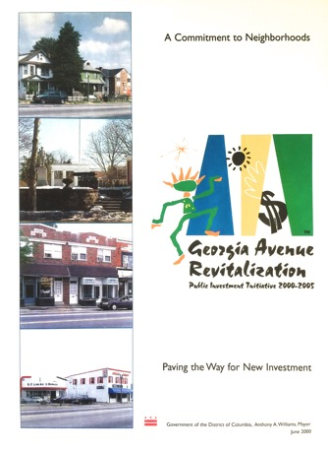
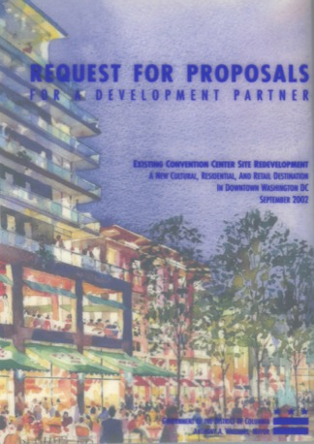
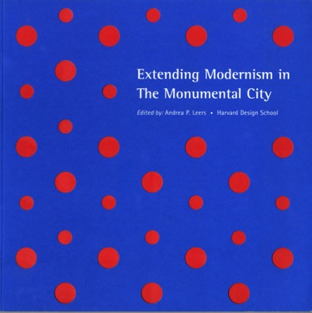
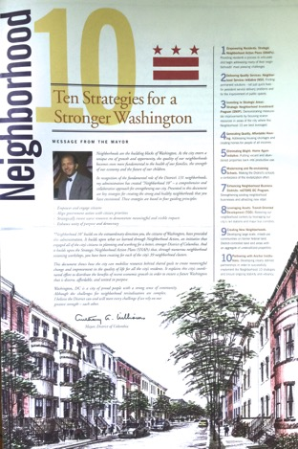
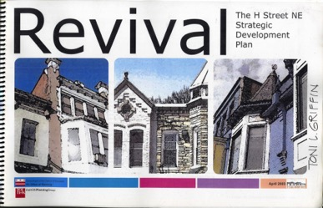
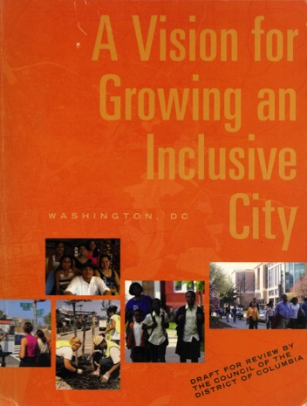
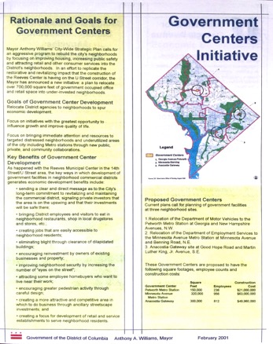
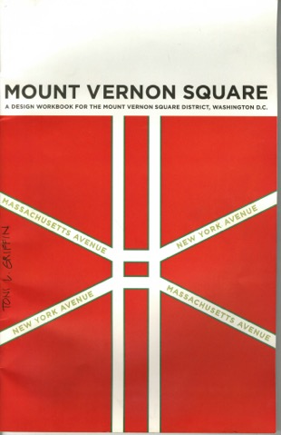
6
YEARS

Slide 11
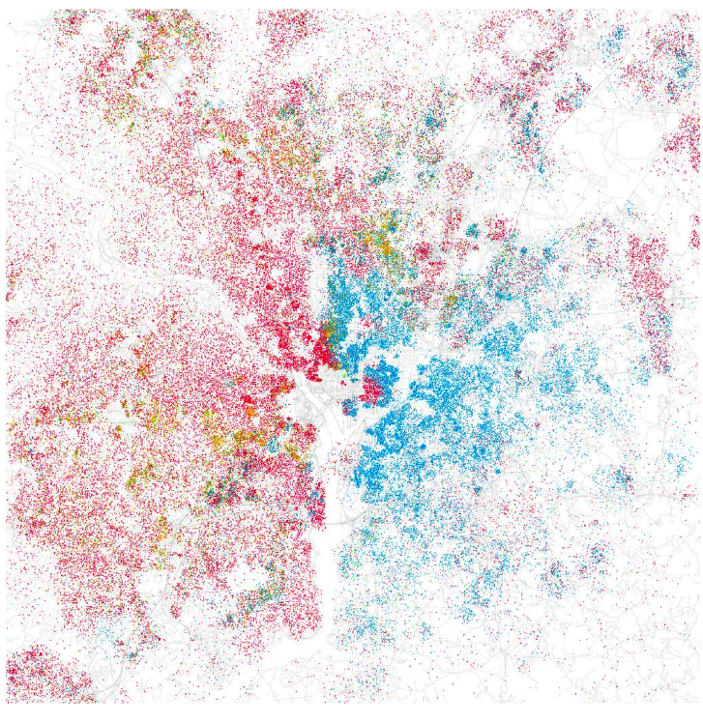
Notes:
Issues of race became more spatially pronounced – the effects still very present in today’s geography

Slide 12
naming
injustice
Notes:
Planning theory should address:
What is the relationship between the urban context and outcome?
How does planning affect city users, including residents, commuters and visitors?
What principles should guide plan the formation, content and implementation?

Slide 13
(urban) injustice
actions and conditions that disadvantage those already excluded from entitlements as a result of unfair discriminatory policies, practices and beliefs.

Slide 14
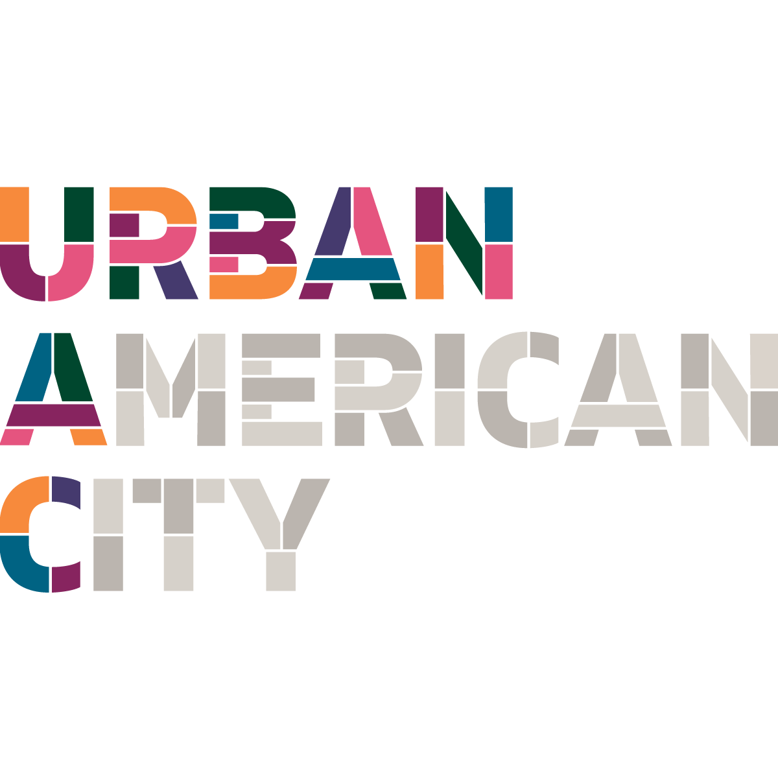
Nixon Moratorium on City and Housing Programs
Environmental Justice Movement
Black Lives Matter Movement
Brown vs. Board of Education 1954
Dr. Martin Luther King Jr. Assassination
Decriminalization of Homosexuality
First Wave - Great Migration
Second Wave - Great Migration
Black Panther Movement
Voting Rights Act of 1965
Civil Rights Act of 1964
World War II Ends
HUD Established
1968
1977
1978
1980
1986
1994
2000
2010
2013
2020
1964
1965
1966
1973
1974
1990
1992
1900
1933
1940
1945
1949
1954
1955
Housing Act of 1949
Model Cities Program
(Target Neighborhoods)
HOPE VI program
The New Deal
(FHA, FNMA, FMAC, WPA)
War on Poverty Program
HOME program
(15% funding to CHODOs)
New Market Tax Credit program
First Settlement Houses established
Empowerment Zones program
Sustainable Communities program
Cities in Transition program
Urban Renewal Act of 1954
(Eminent Domain, Bypasses Mayor for Redevelopment Authorities)
Ford Foundation “Gray Areas” Program
Urban Development Action Grant Program
(Federal Funding with private match)
Low Income Housing Tax Credit program
Neighborhood Reinvestment Corporation
Community Development Block Grant Program
(Funding to Mayors via formula)
Local Initiative Support Corporation (LISC) created
Enterprise Foundation created
Notes:
Our only exposure to the contributing environmental, social and economic issues that have contributed to the existing condition is predominately only known through the urban policies and financing tools that drive the scope of the design program designers are created solutions for. As such, urban policies have a significant influence over are what shapes the narratives of the built world we live within today.
But what designer worked not in response to urban public policy, but in response to and alongside social movements?

Slide 15
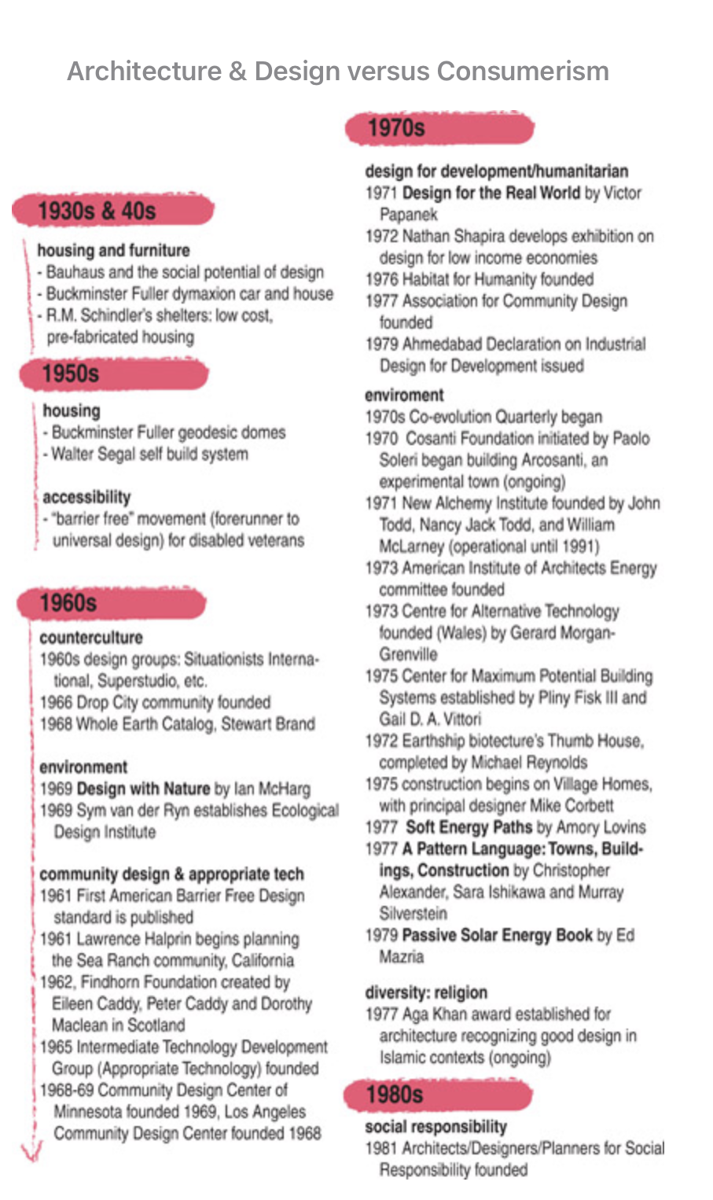
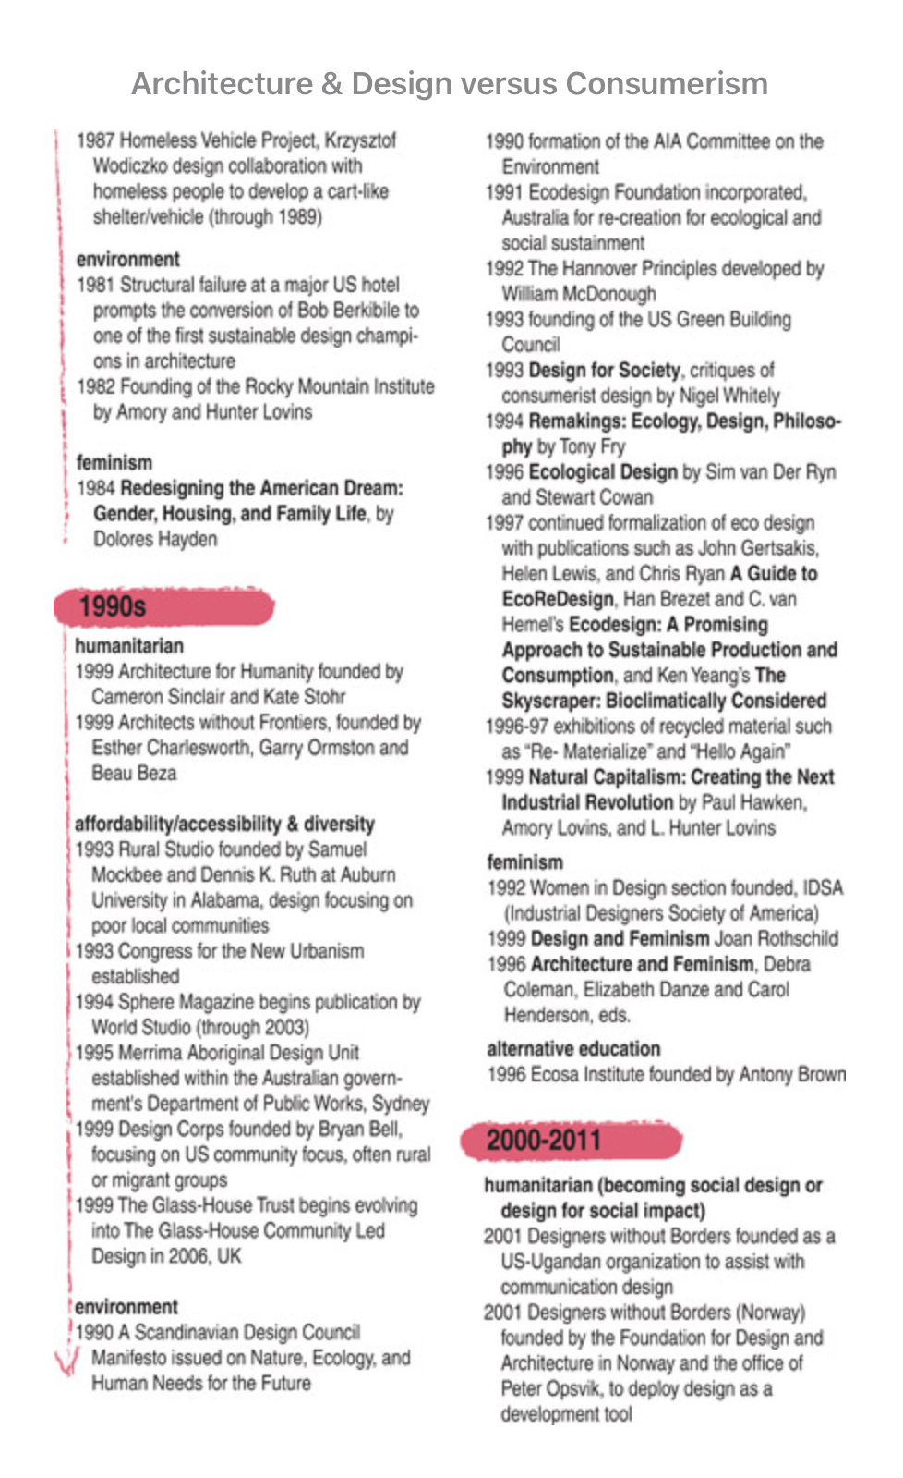
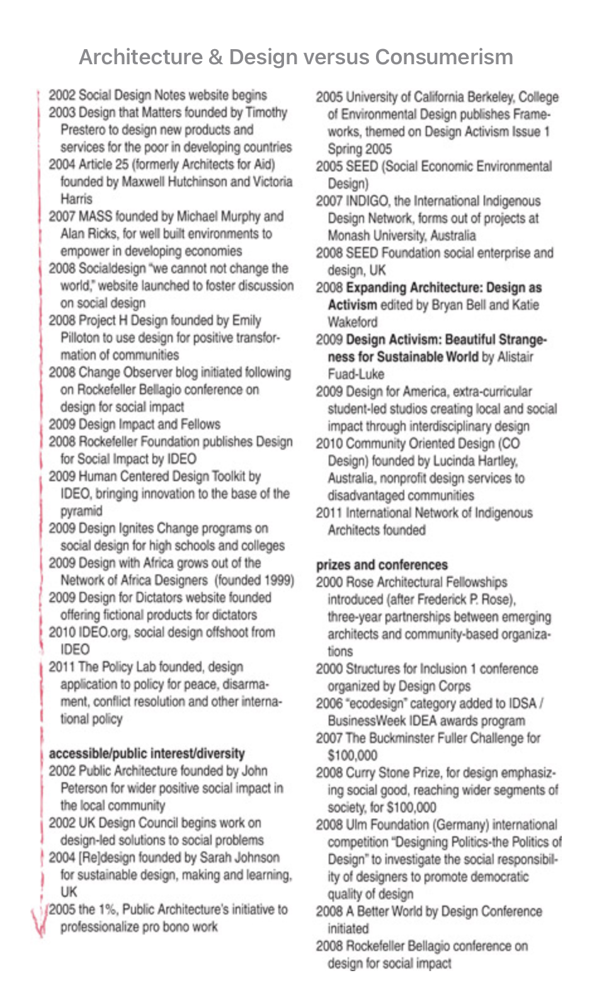
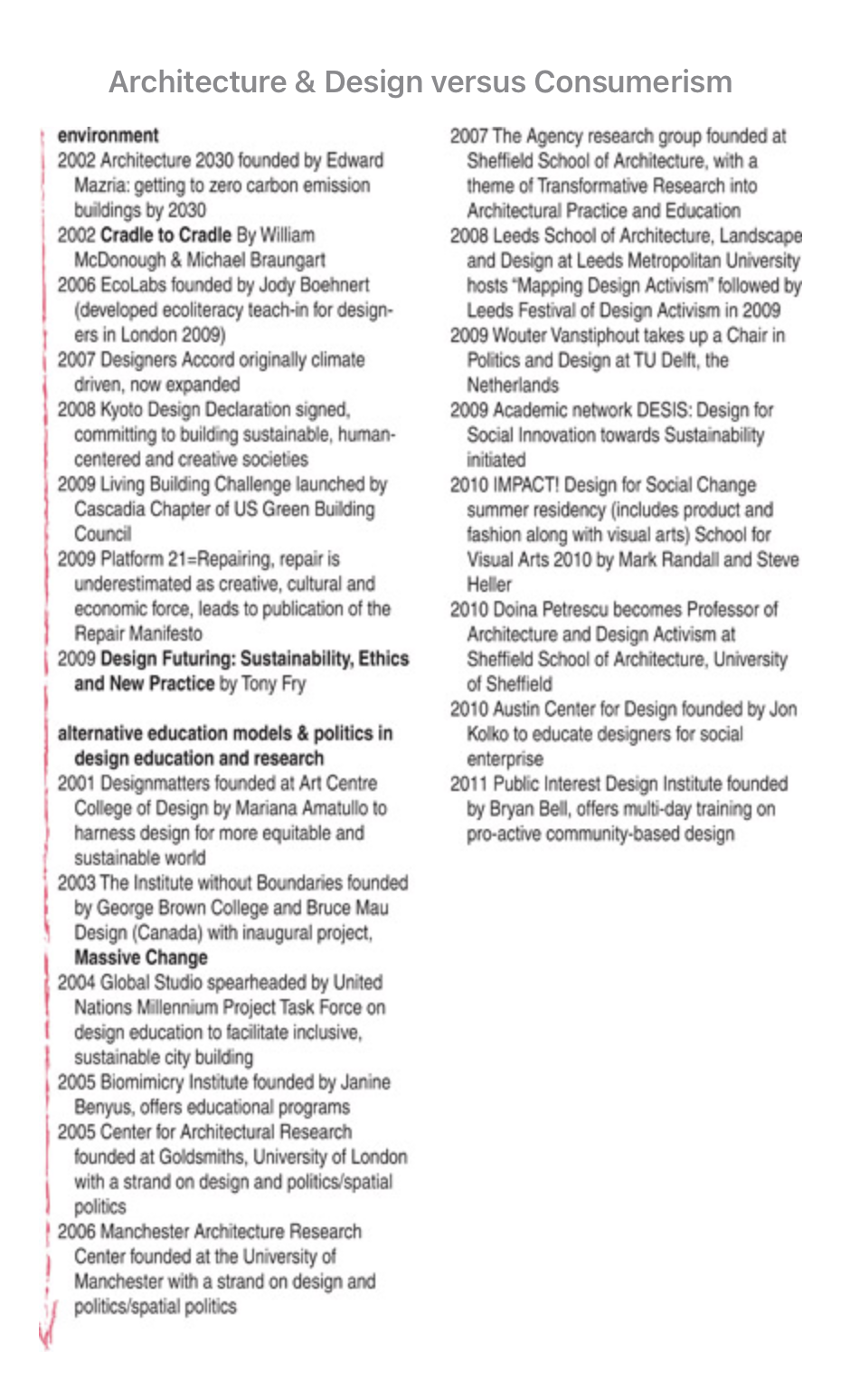
AGRARIAN URBANISM
MODERNISM
ENVIRONMENTAL DESIGN
LANDSCAPE URBANISM
HUMAN-CENTERED DESIGN
DESIGN FOR THE JUST CITY
COMMUNITY DESIGN
PATTERN LANGUAGE
RESILIENT CITIES
SOCIAL IMPACT DESIGN
DEISGN JUSTICE SUMMIT
Notes:
We applaud ourselves for ascribing to the values of creating healthy, sustainable, and equitable places. And there is evidence that our design movements or agendas have seized opportunities align with the environmental, social and economic issues of the time to advance spatial and aesthetic solutions.
By layering social, design and urban policy movements, designers would be in a better position to influence the bottom up and top down
the urban condition narratives articulated through public policy
the advocacy narratives articulating people’s desired solutions for change through activism and protest

Slide 16
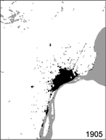
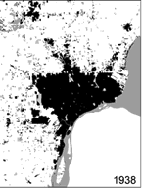
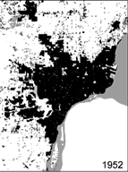
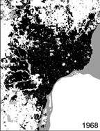
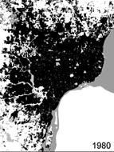
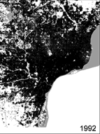
sprawl
Notes:
The early early years of their new northern life are going well and prosperous.
But things begin to change for these families and the city of Detroit by 1950, just as the city reaches its peak population of 1.8 million people.
A second migration begins known as suburban sprawl.
Fueled by new technologies for making cars, cheaper ways to travel because of new interstate highways and easier ways to by homes with federal home loan programs – all making it easier for families and businesses to flee the aging congested city
This map shows the progression on how the Detroit metro region grew beyond the city limits. Between 1950 and today, the region’s population grows by 30%

Slide 17
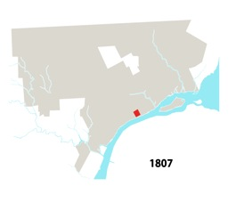
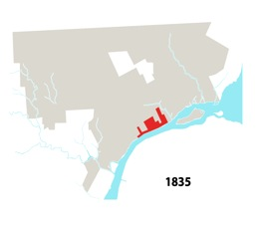
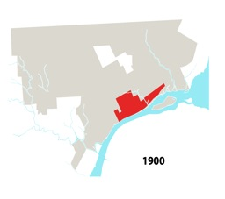
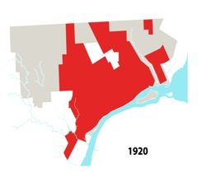
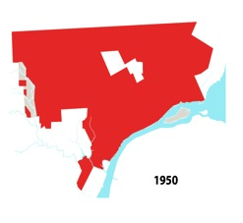
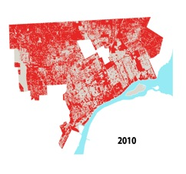
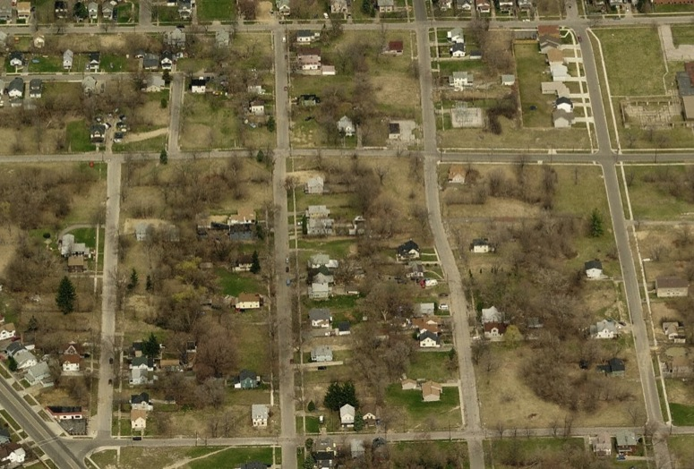
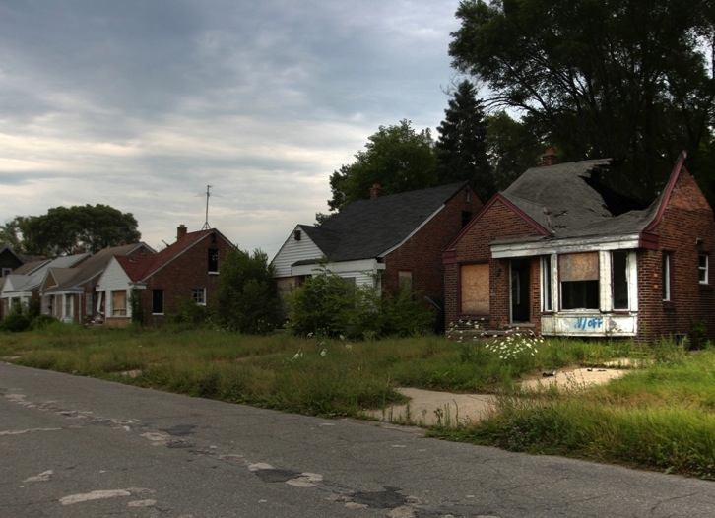
abandonment
SOURCE: Bing Maps
Notes:
Detroit city between 1807 - 2010

Slide 18
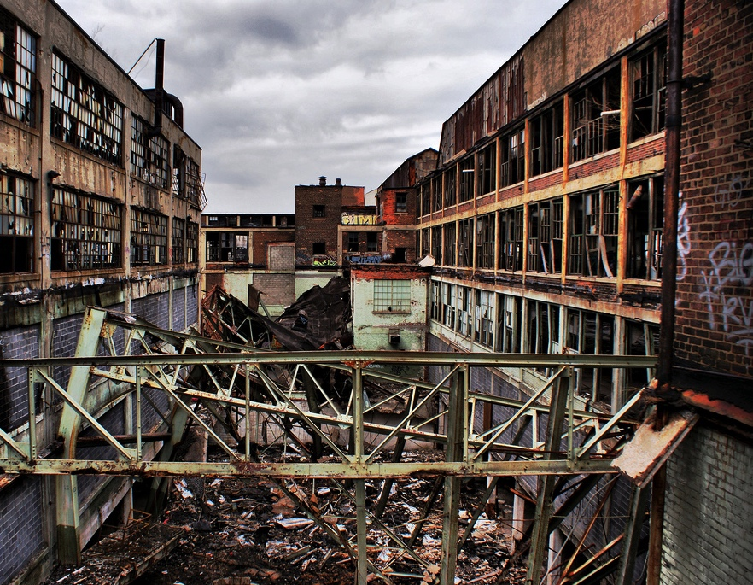
blight
Notes:
In my studio, students universally have rejected the idea of ruin as spectacle as the simplest way to mothball the city.
But to be fair, we might need to support the and allow for entrepreneurial and appropriated geographies as necessary forms of stewardship, civic capacity building and shared responsibility.

Slide 19
vacancy
SOURCE: DANA BRECHWALD, GSD

Slide 20
succession

Slide 21
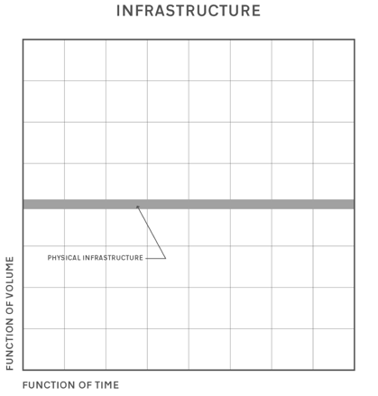
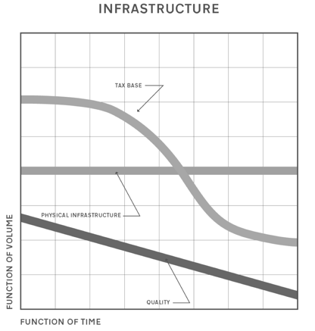
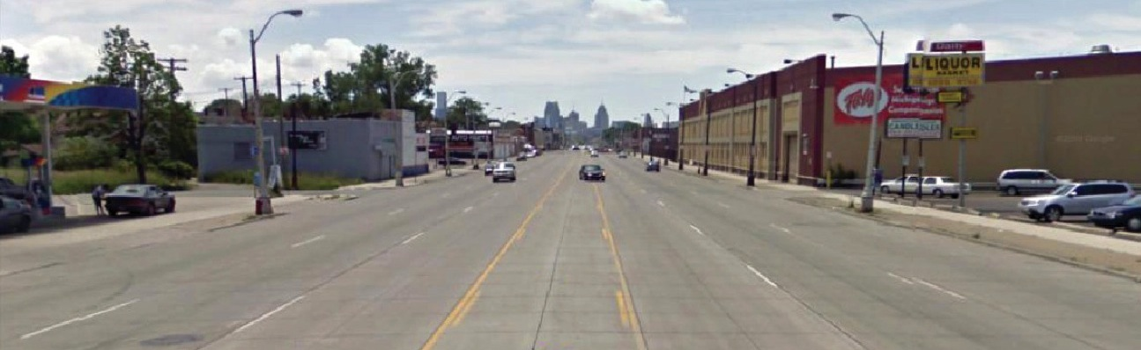
waste
Notes:
This programmatic and population erosion leads to an underutilization of infrastructure

Slide 22
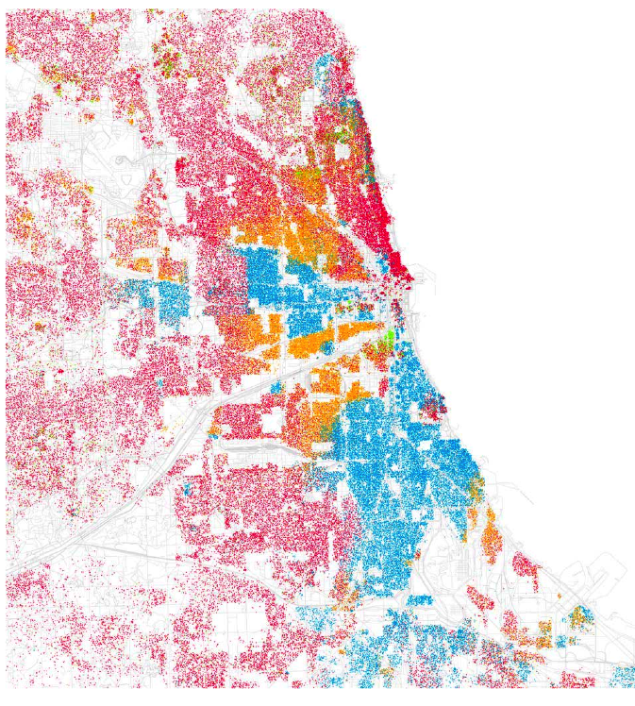
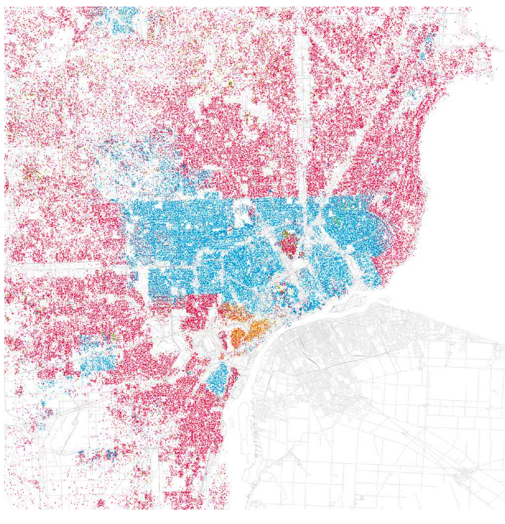
race
Notes:
Issues of race became more spatially pronounced – the effects still very present in today’s geography

Slide 23
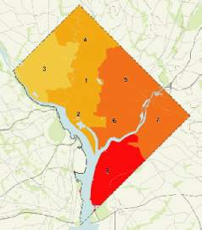
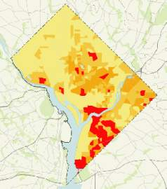
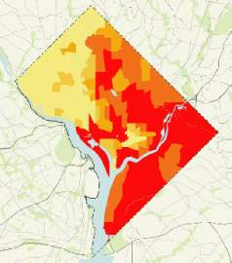
Unemployment
Poverty
Education
class
Notes:
Startling data about poverty, education, and employment reminds of us the still segregated city – segregated around unemployment, class and educational attainment.

Slide 24
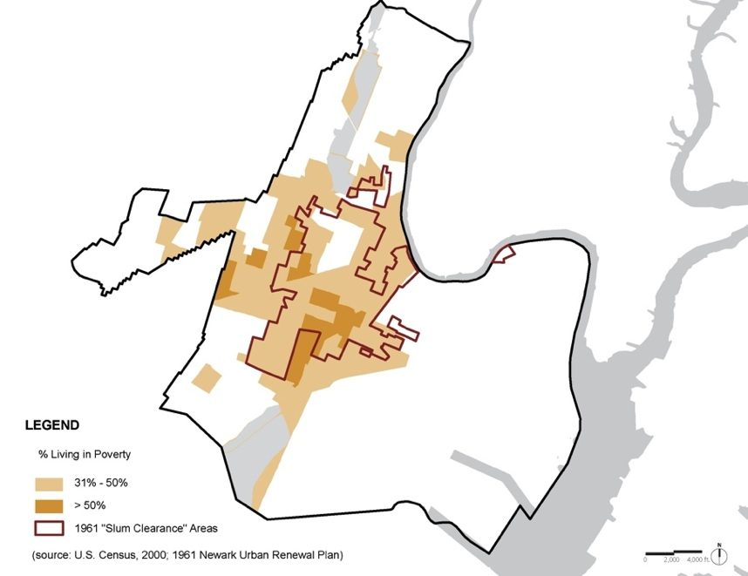
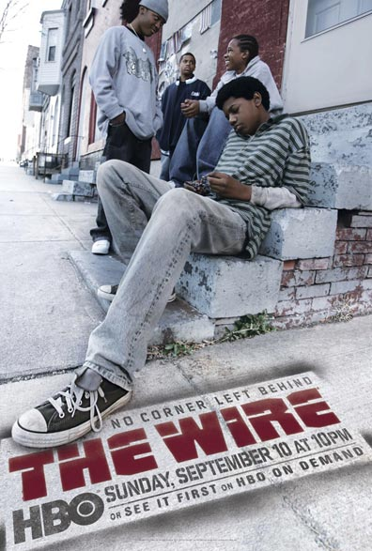
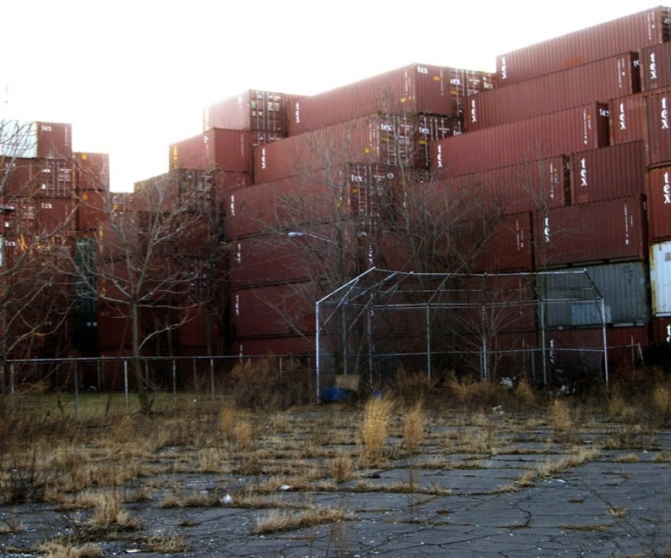
isolation
Notes:
24
The results of sprawl and abandonment has created a spatial isolation that has had a devastating impact on social and family structures, educational systems and access to economic opportunity
Demographic isolation
Physical isolation through boundaries
Social isolation through limited access

Slide 25
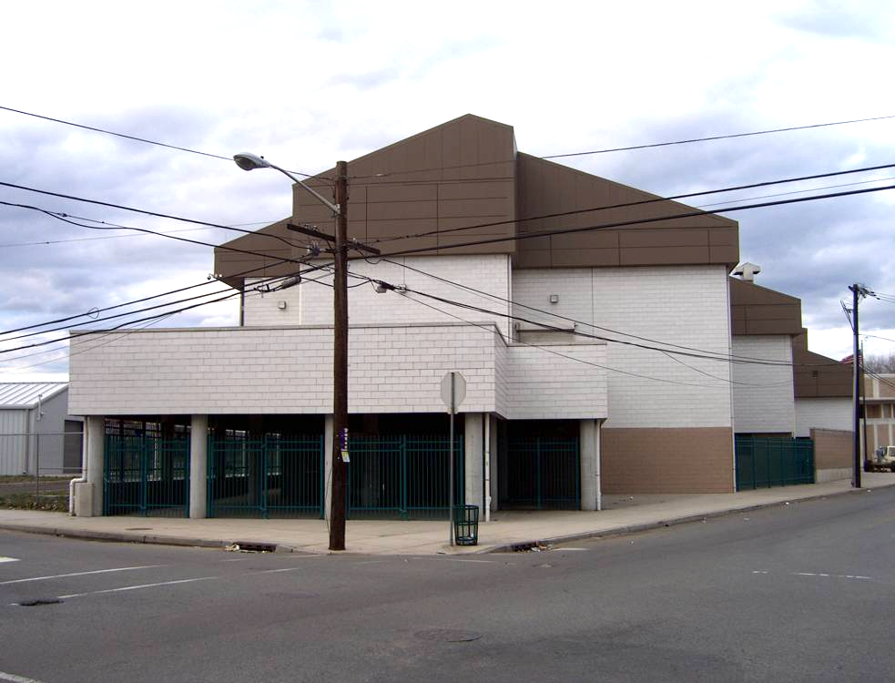
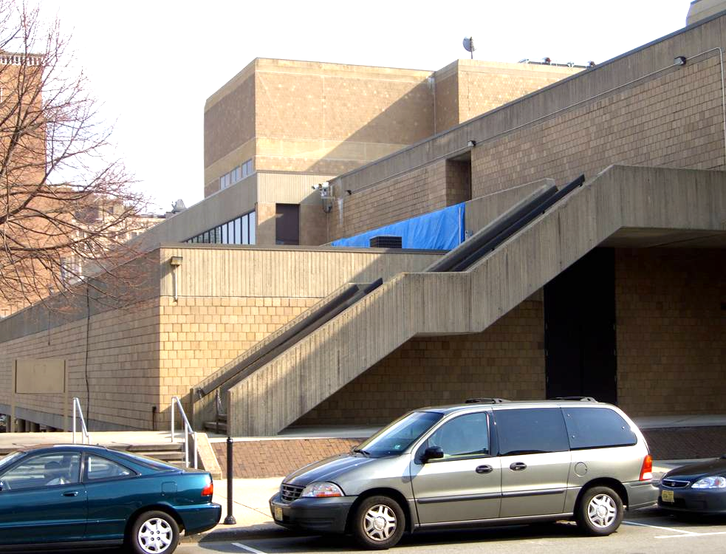

separation
Notes:
25
o/graphics/misc/PPTMaster/PPTMaster.pot
25
Isolation and entrenchment contributed to an architecture of fear.
Eyes on the street become, sidewalks in the air, elevated entrances, and gated front doors.

Slide 26

gentrification
Notes:
Beliefs that a certain group of people have the deliberate intention to remove and displace populations of “other” as a form of urban reclamation and profit are commonly held, especially by those who feel that do not benefit from gentrification

Slide 27




climate

Slide 28
what is justice?
Notes:
For many who we seek justice for, their injustice is situated in the spaces of the city. A series of conditions instigated by public policy, advanced by private capital, deepened by generational poverty and disinvestment, and stigmatized by…

Slide 29


Slide 30
Distributive justice
Distributive justice, also known as economic justice, is about fairness in what people receive, from goods to attention. Its roots are in social order and it is at the roots of Communism, where equality is a fundamental principle.
If people do not thing that they are getting their fair share of something, they will seek first to gain what they believe they deserve. They may well also seek other forms of justice.
Procedural justice
The principle of fairness is also found in the idea of fair play (as opposed to the fair share of distributive justice).
If people believe that a fair process was used in deciding what it to be distributed, then they may well accept an imbalance in what they receive in comparison to others. If they see both procedural and distributive injustice, they will likely seek restorative and/or retributive justice.
Restorative justice
The first thing that the betrayed person may seek from the betrayer is some form of restitution, putting things back as they should be.
The simplest form of restitution is a straightforward apology. Restoration means putting things back as they were, so it may include some act of contrition to demonstrate one is truly sorry. This may include action and even extra payment to the offended party.
Restorative justice is also known as corrective justice.
Retributive justice
Restoration may well not be enough for the betrayed person and they may seek revenge of some sort, whereby they can feel the satisfaction of seeing the other person suffer in the way that they have suffered.
Revenge can be many times more severe than reparation as the hurt party seeks to make the other person suffer in return.
DISTRIBUTIVE
RESTORATIVE
Also known as economic justice, is about fairness in what people receive, from goods to attention. Its roots are in social order, where equality is a fundamental principle.
The first thing that betrayed people may seek from the betrayer is some form of restitution, putting things back as they should be.
justice is…
(understanding before remedy)
PROCEDURAL
INTERACTIONAL
The principle of fairness is also found in the idea of fair play (as opposed to the fair share.
The concept of interactional justice is about the quality of interpersonal interactions in a specific situation or place that include truthfulness, respect, propriety and justification.
Notes:
Distributive justice.
is about fairness in what people receive, from goods to attention. If people do not think that they are getting their fair share of something, they will seek first to gain what they believe they deserve.

Slide 31
why
justice
Notes:
For many who we seek justice for, their injustice is situated in the spaces of the city. A series of conditions instigated by public policy, advanced by private capital, deepened by generational poverty and disinvestment, and stigmatized by…

Slide 32


power
Notes:
It is time for justice because of historical and current power imbalances within institutions that are not representative of the people they serve, yet make decisions on their behalf

Slide 33

prejudice
Pinterest Tyler Demarce
Notes:
Its time for justice because intolerance of difference is a devaluing of humanity

Slide 34

privilege
Business Insider, 2015
Notes:
Its time for justice because growing economic disparity hurts us all

Slide 35

policy
Notes:
Its time for justice because without knowing the history of intentional racism, built into the policies that designed our cities, we will never effectively create livable sustainable or resilient cities

Slide 36

intolerance
Notes:
And its time for justice because ignorance drives fear, fear drive hate and hate drives violence – a violence we are being forced to witness daily and with minimal repercussion.

Slide 37

racial justice
American Exceptionalism
Equality
Equity
American Liberation

Slide 38
justice for who?
justice for what?
Notes:
So how is justice for?
We have been taught to recite “…with liberty and justice for all…”, but I think its safe to safe, not everyone has the same liberties and justice has not come to all

Slide 39
Notes:
Social consciousness or benevolent

Slide 40

body|immigrant
Notes:
This country is built on multiculturalism, yet there are those who believe some don’t belong here

Slide 41

body|women
Notes:
Justice is not just a black and white issue.
The eroding of health protections for women

Slide 42

body|bipoc
Notes:
All lives matter is not the same as Black lives matter

Slide 43

body|LGBTQ+
Notes:
And the LGBTQ community

Slide 44

voice|faith
Notes:
The fear of faith

Slide 45

voice|protest
Notes:
Those who stand up or sit down for the change they want to see

Slide 46

voice|memory
Notes:
Who gets to narrate and make visible our history and who doesn’t

Slide 47

belonging|city
Notes:
The segregating, gating and walling of neighborhoods and cities

Slide 48

belonging|planet
Notes:
Our bodies are not the only assets under attack.
The erosion of our ecosystem and the measures that protect our environment

Slide 49
the just city
is a laboratory
Notes:
Planning theory should address:
What is the relationship between the urban context and outcome?
How does planning affect city users, including residents, commuters and visitors?
What principles should guide plan the formation, content and implementation?

Slide 50

Notes:
I address the conditions of injustice and the pursuit of justice through design. 10 years ago, I grew skeptical of design ability to alter the trends of social and spatial injustice and in fact, was being to more deeply understand our contributions to it. At that point, I launched my firm, urban American city, and began a teaching a research agenda aimed at investigating our role and impact – fully prepared to expose our collective failures and successes.
I’ll start my summary of some of this work with the Just City Lab, my research platform at the Harvard graduate school of design, where I am a professor in practice in urban planning.

Slide 51

a Just City is where all people and communities, but especially the least not included, have access to networks and environments that offer the opportunities and resources to be productive and prosperous, advancing their social and economic mobility and agency.
Notes:
After years of course curriculum and crowd-sourcing the question – can design have a positive impact on social and spatial justice – the lab as formulated its point of view about the just city
a Just City is where all people and communities, but especially the least not included, access to NETWORKS AND environments that offer the opportunities and resources to be productive and prosperous, advancing their social and economic mobility and agency.

Slide 52

RESEARCH
we investigate ways that designers combat social + spatial injustice, and showcase their solutions through case studies and exhibitions

Slide 53
SPECULATE
cross-disciplinary design studios to analyze, speculate and project new futures that dismantle socio-spatial injustice
Notes:
the Just City Index is a language of 50 values intended to be used by communities to self-select and define what makes for a more Just City

Slide 54






PUBLISH

Slide 55


exhibit
Design for the Just City
Harvard Graduate School of Design
2018
Design and the Just City in NYC
Center for Architecture
2019

Slide 56

engage
the Just City Index is a language of 50 values intended to be used by communities to self-select and define what makes for a more Just City
Notes:
the Just City Index is a language of 50 values intended to be used by communities to self-select and define what makes for a more Just City

Slide 57





convene

Slide 58
evaluate
creating evidence-based research on the presence of social and spatial justice in the built environment
Notes:
the Just City Index is a language of 50 values intended to be used by communities to self-select and define what makes for a more Just City

Slide 59



Notes:
We use the index as a tool of engagement when accessing a common language to talk about conditions of injustice is needed. We have used this tool in convening in South Africa, Rotterdam, Amsterdam and for conversations ranging from black futurism, aging in place and the designing justice.
We document both the conditions of injustice found in different settings, as well as values important to each city or setting to both aggregate an compare visions of justice by city, age, race and gender.

Slide 60
the just city
is a practice
Notes:
Planning theory should address:
What is the relationship between the urban context and outcome?
How does planning affect city users, including residents, commuters and visitors?
What principles should guide plan the formation, content and implementation?

Slide 62

just urbanism
restorative
grasstops
grassroots
values-based
disruptive
cross disciplinary
cultural competency
political
accountability
community expertise
our principles
are built on a disruptive framework of policies and practices that produce outcomes designed to break down historic structures and systems of oppression, inequality and access
just urbanism

Slide 63

Guiding INCLUSIVE growth
South Capitol Street Bridge
and
Gateway
Southeast Federal Center and
Waterfront Park
Hope VI Redevelopment and
Canal Blocks Park
Hill East Waterfront
and
The Meadows Park
Anacostia Riverwalk and Trail
Southwest Waterfront
with
Market Square
and
Civic Park
Poplar Point
Cultural Park
and
Howard Road Development
Reinvestment at East of the River Gateways
Waterfront Light Rail Line
Notes:
Unsatisfied with these limits, I take my first professional pivot, applying and accepting a Loeb Fellowship here at the GSD, and instead of returning to SOM, I move into the public sector.
Detroit and the Fellowship highlighted the agency of mayors as the architects of cities
The pivot to city leadership changed my agency to a designer now equipped with the power to design and implement

Slide 64


REIMAGINING CITIES IN TRANSITION

Slide 65


INCLUSIVE PUBLIC PLACES

Slide 66


BUILDING COMMUNITY WEALTH
        The Neighborhood REIT is community-controlled and managed.
Community Investors have an ownership stake through agency over :
Governance process
Developmental trajectories
Financial Asset investments
Intangible assets (trust-building, sweat equity)
Investors receive regular dividends as the value of the property assets increase
Notes:
The REIT industry is an X billion dollar industry and a proven model - a NREIT is a new version of this

Slide 67
how will you consider
justice and the city
Notes:
For many who we seek justice for, their injustice is situated in the spaces of the city. A series of conditions instigated by public policy, advanced by private capital, deepened by generational poverty and disinvestment, and stigmatized by…

Slide 68
can we design for justice?
who must we design justice for?
can we measure the impact of design on justice?
Notes:
For many who we seek justice for, their injustice is situated in the spaces of the city. A series of conditions instigated by public policy, advanced by private capital, deepened by generational poverty and disinvestment, and stigmatized by…

Slide 69


Slide 70


Slide 71


Slide 72


Slide 73


Slide 74


Slide 75


Slide 76


Slide 77


Slide 78


Slide 79


Slide 80


Slide 81


Slide 82


Slide 83


Slide 84


Slide 85


Slide 86
workshop reflection #1
Notes:
For many who we seek justice for, their injustice is situated in the spaces of the city. A series of conditions instigated by public policy, advanced by private capital, deepened by generational poverty and disinvestment, and stigmatized by…

Slide 87
cultivating your
why?
Notes:
For many who we seek justice for, their injustice is situated in the spaces of the city. A series of conditions instigated by public policy, advanced by private capital, deepened by generational poverty and disinvestment, and stigmatized by…

Slide 88
Why is dismantling
injustice and inequity important to you?
Notes:
For many who we seek justice for, their injustice is situated in the spaces of the city. A series of conditions instigated by public policy, advanced by private capital, deepened by generational poverty and disinvestment, and stigmatized by…

Slide 89
Three Whys:
moments of clarity
A volunteer reads their statement
1st person asks “why”
Volunteer responds…
2nd person asks “why”
Volunteer responds…
Notes:
For many who we seek justice for, their injustice is situated in the spaces of the city. A series of conditions instigated by public policy, advanced by private capital, deepened by generational poverty and disinvestment, and stigmatized by…

Slide 90
workshop reflection #2
Notes:
For many who we seek justice for, their injustice is situated in the spaces of the city. A series of conditions instigated by public policy, advanced by private capital, deepened by generational poverty and disinvestment, and stigmatized by…

Slide 91
a just city
language
…words and meanings
Notes:
For many who we seek justice for, their injustice is situated in the spaces of the city. A series of conditions instigated by public policy, advanced by private capital, deepened by generational poverty and disinvestment, and stigmatized by…

Slide 92



