Slide 1
city
racial dot maps
Notes:
Planning theory should address:
What is the relationship between the urban context and outcome?
How does planning affect city users, including residents, commuters and visitors?
What principles should guide plan the formation, content and implementation?

Slide 2
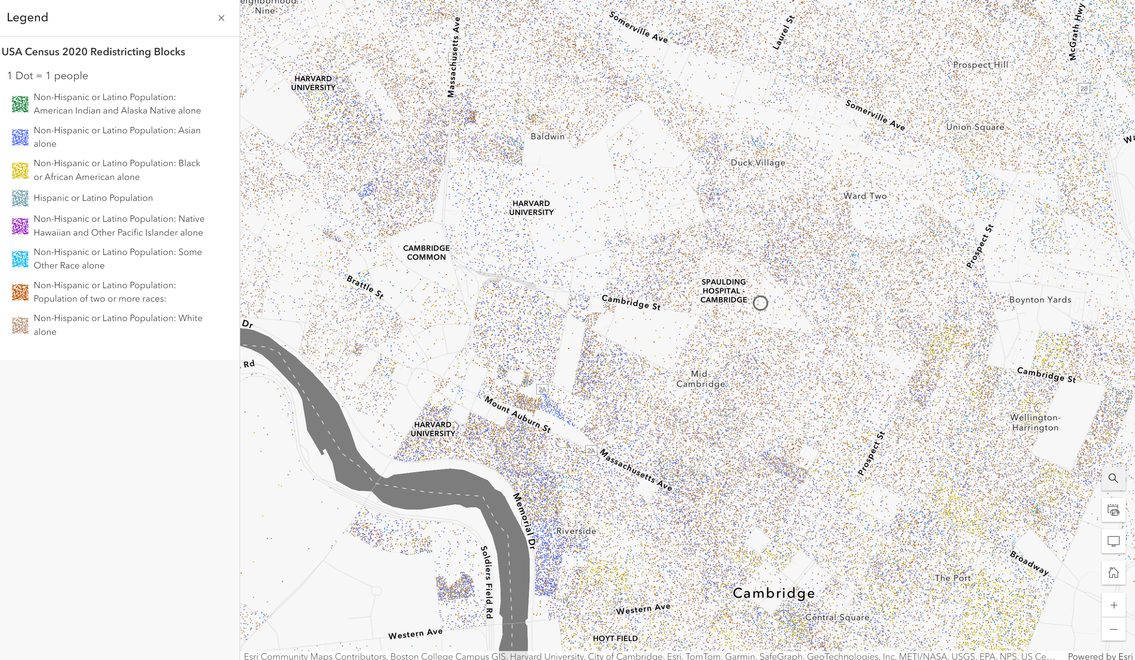
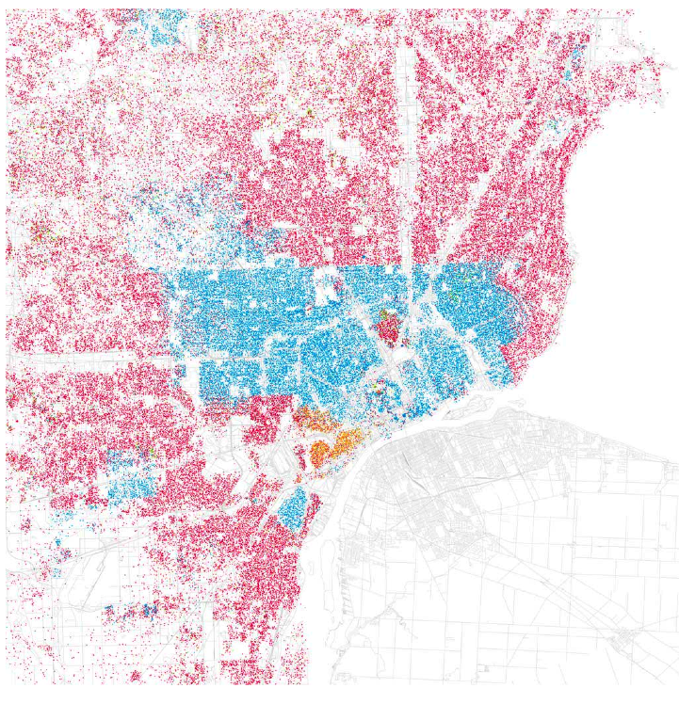
Cambridge, MA
Notes:
Issues of race became more spatially pronounced – the effects still very present in today’s geography

Slide 3
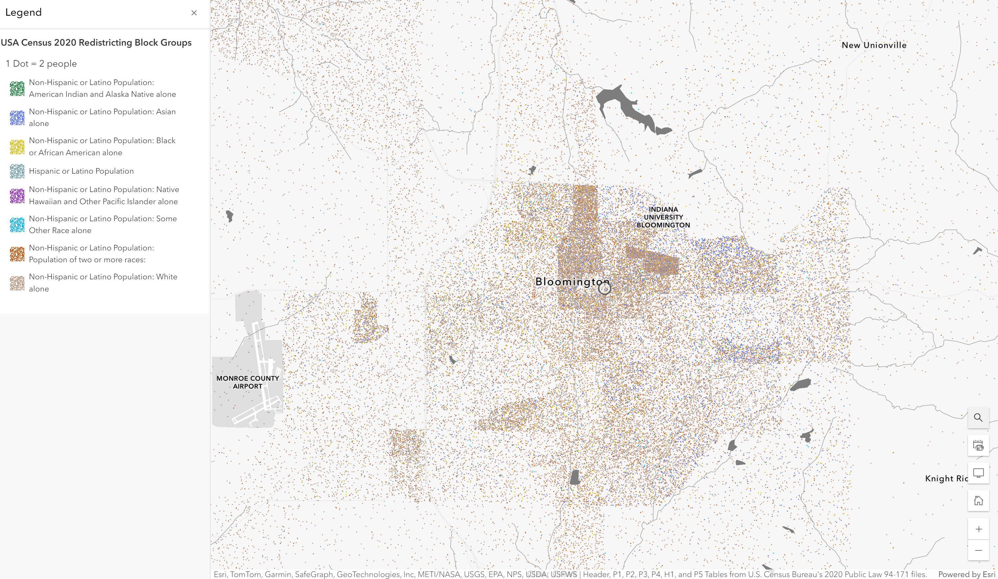
Bloomington, IN
Notes:
Issues of race became more spatially pronounced – the effects still very present in today’s geography

Slide 4
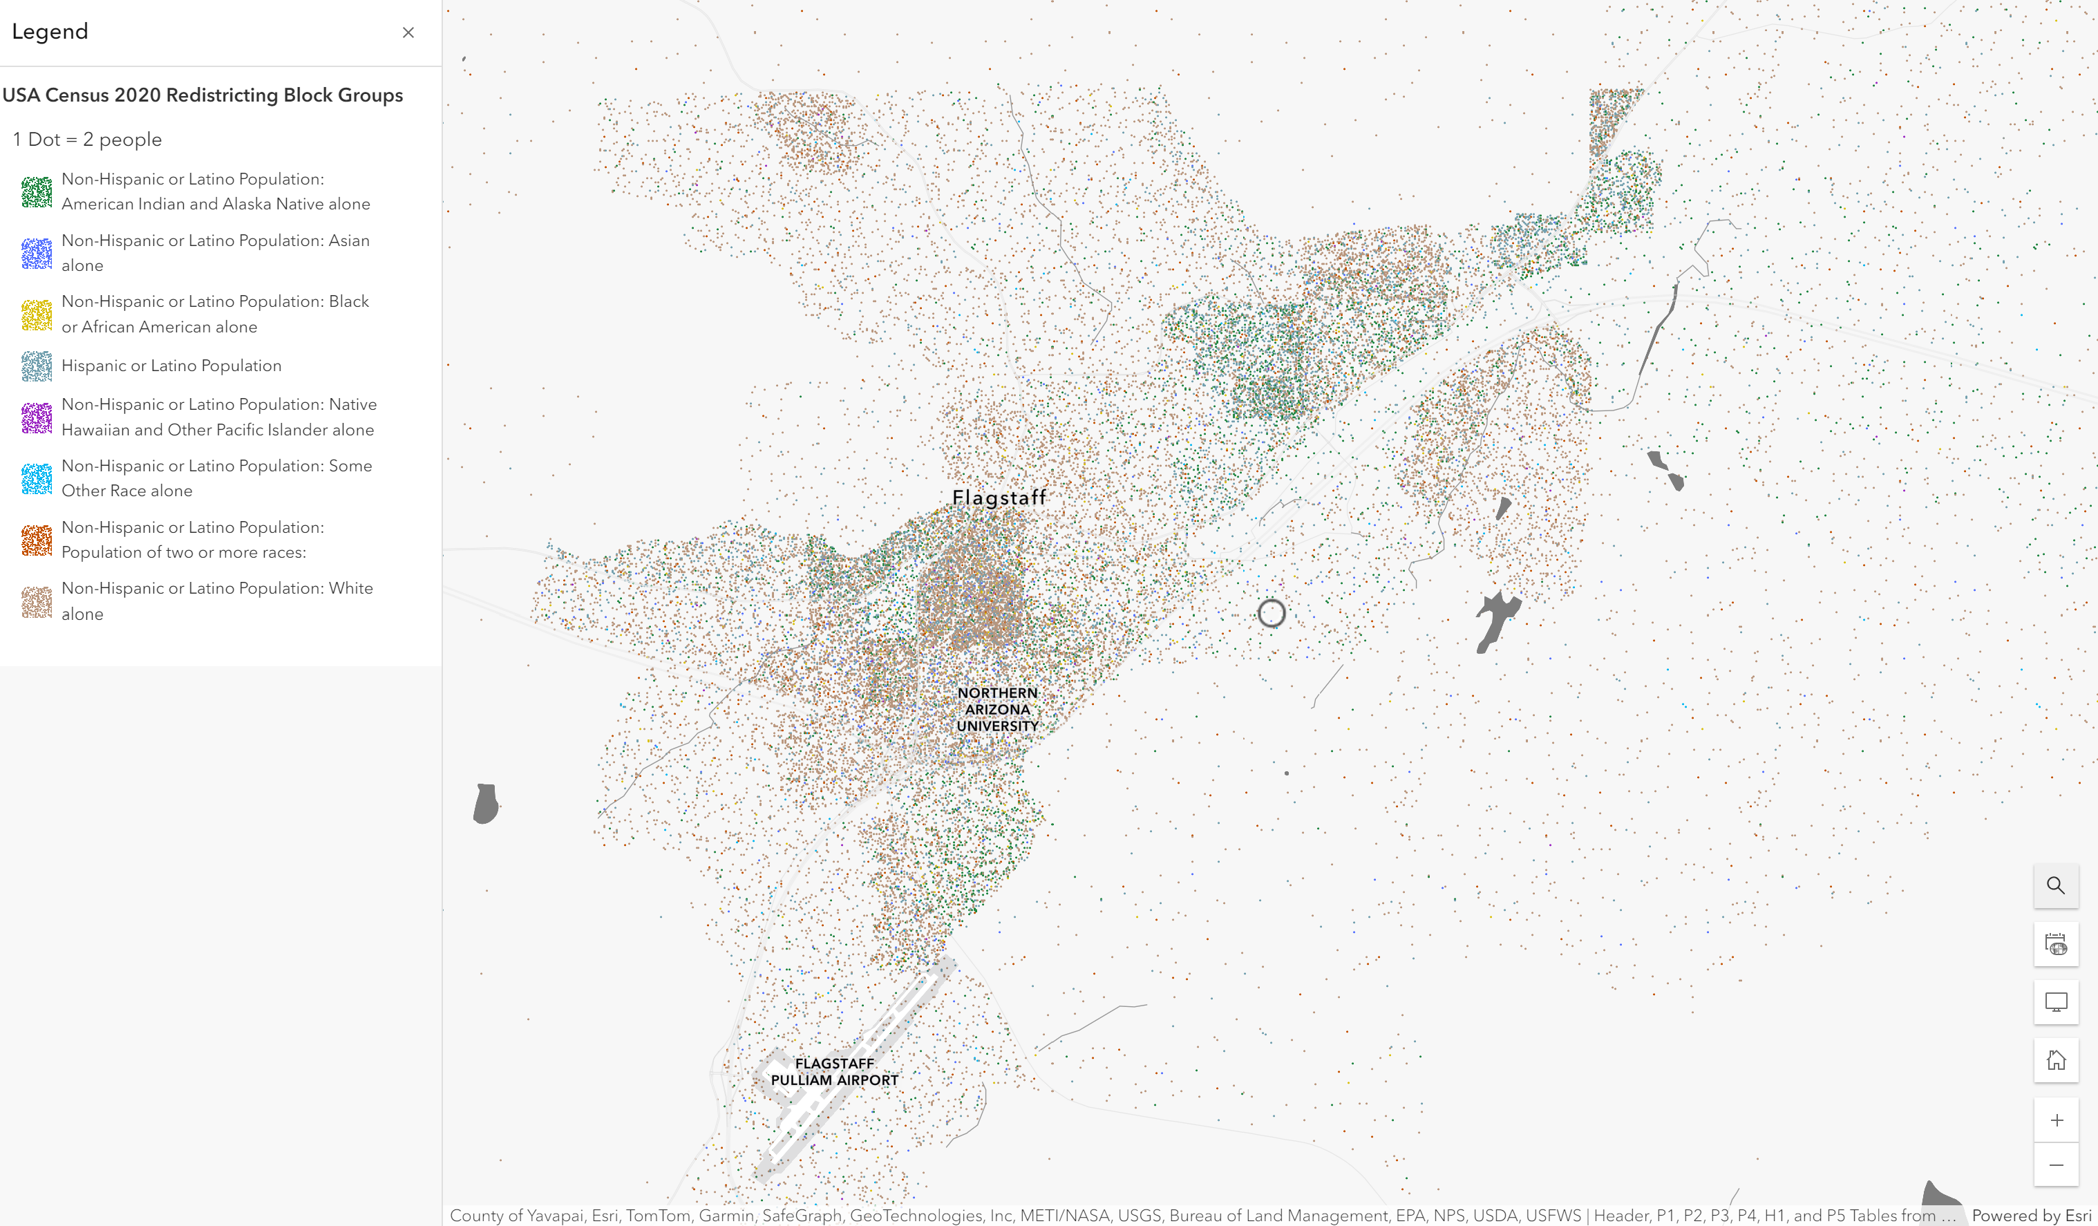
Flagstaff, AZ
Notes:
Issues of race became more spatially pronounced – the effects still very present in today’s geography

Slide 5
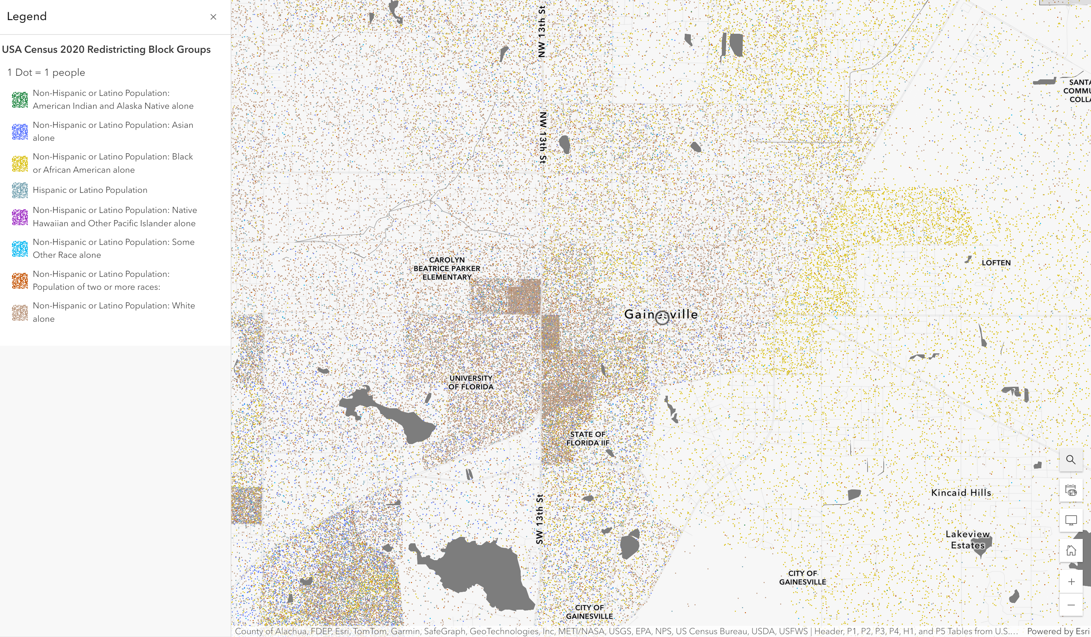
Gainesville, FL
Notes:
Issues of race became more spatially pronounced – the effects still very present in today’s geography

Slide 6
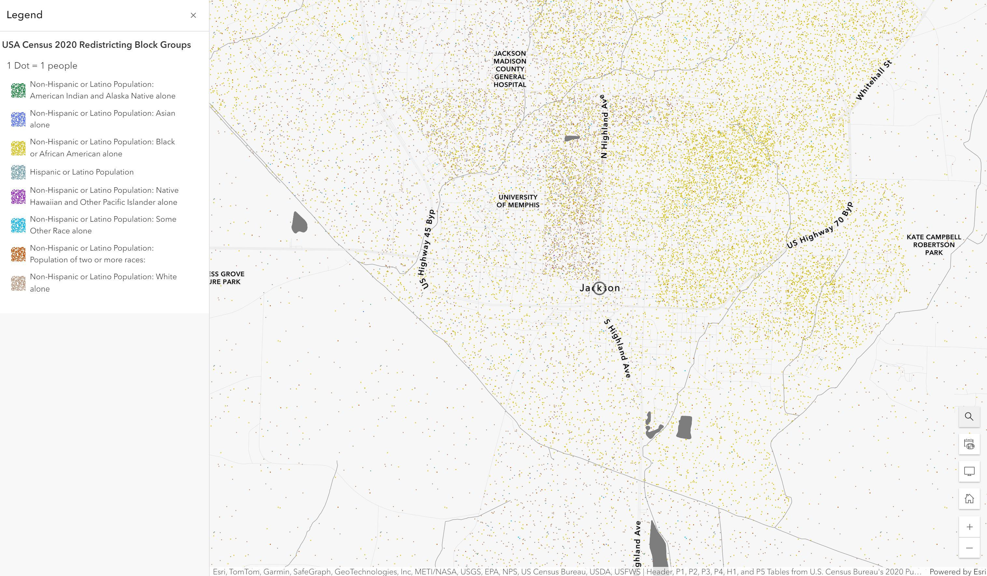
Jackson, TN
Notes:
Issues of race became more spatially pronounced – the effects still very present in today’s geography

Slide 7
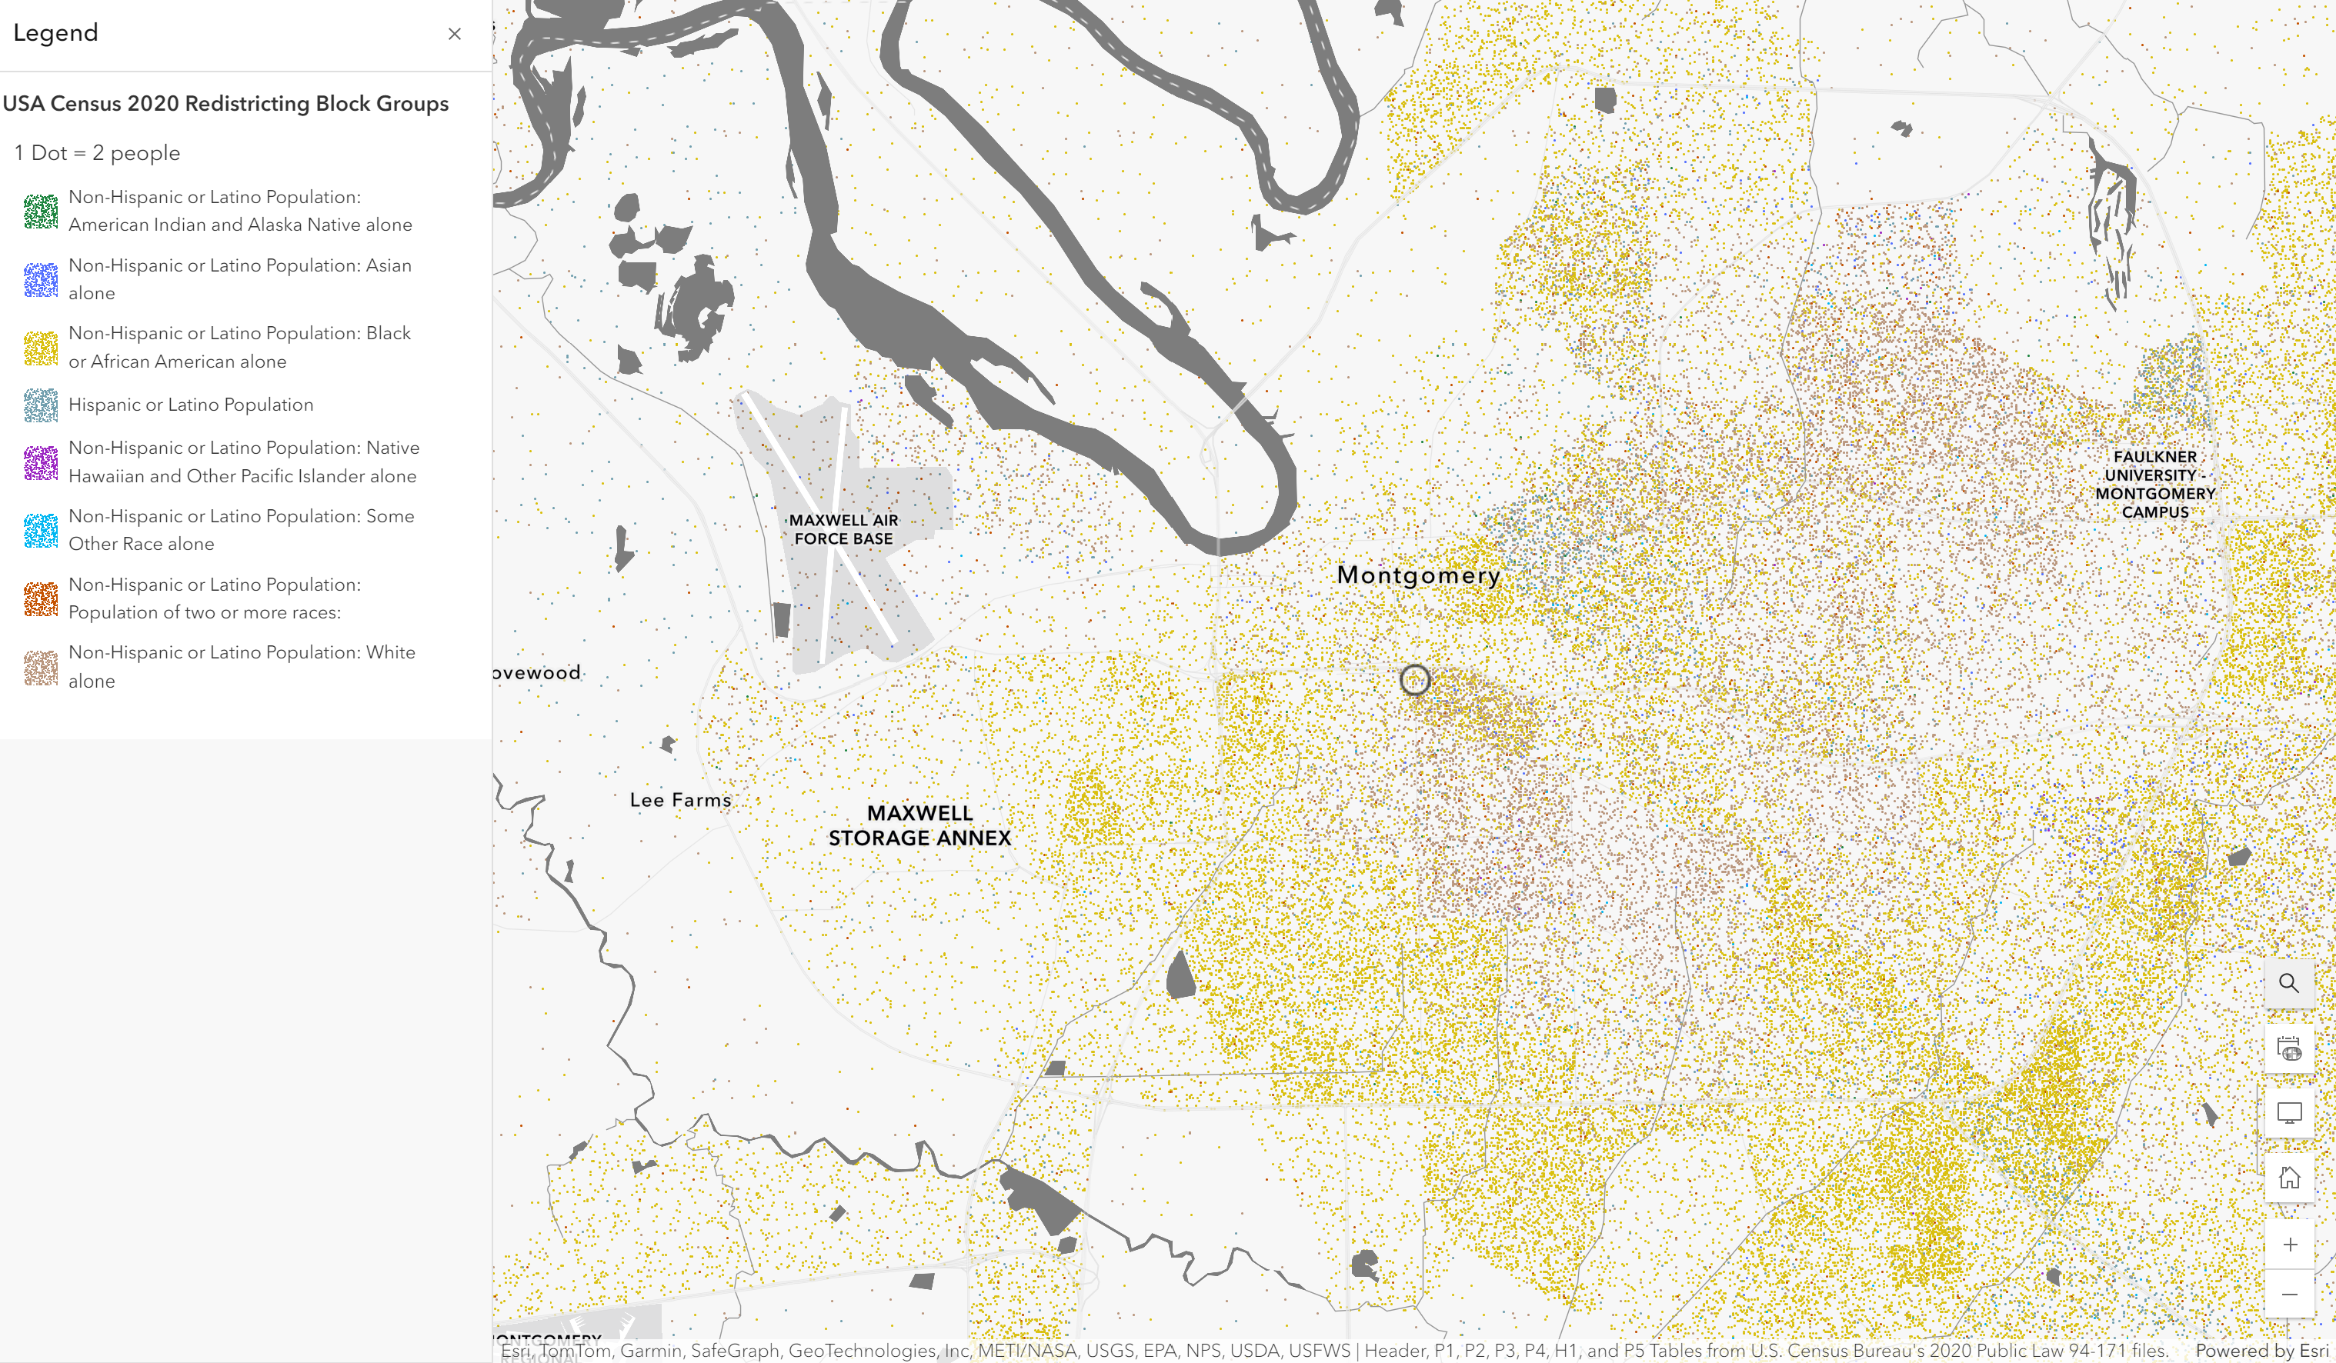
Montgomery, AL
Notes:
Issues of race became more spatially pronounced – the effects still very present in today’s geography

Slide 8
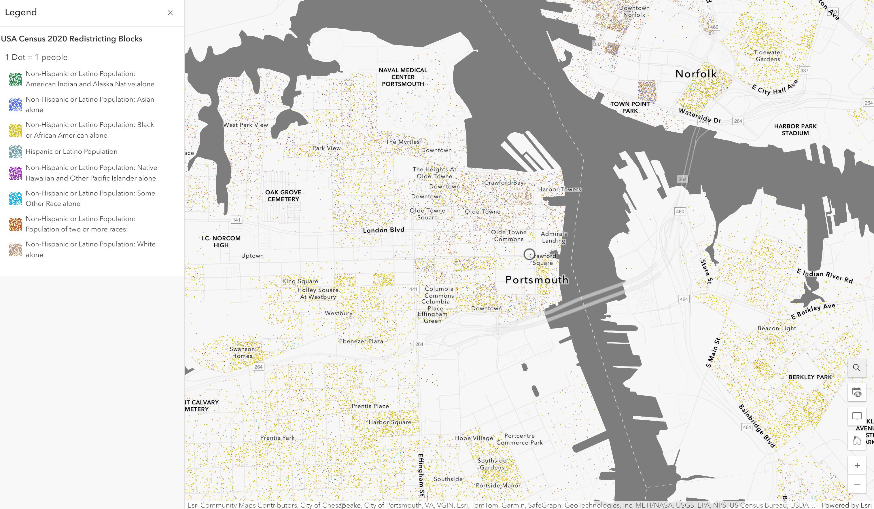
Portsmouth, VA
Notes:
Issues of race became more spatially pronounced – the effects still very present in today’s geography

Slide 9
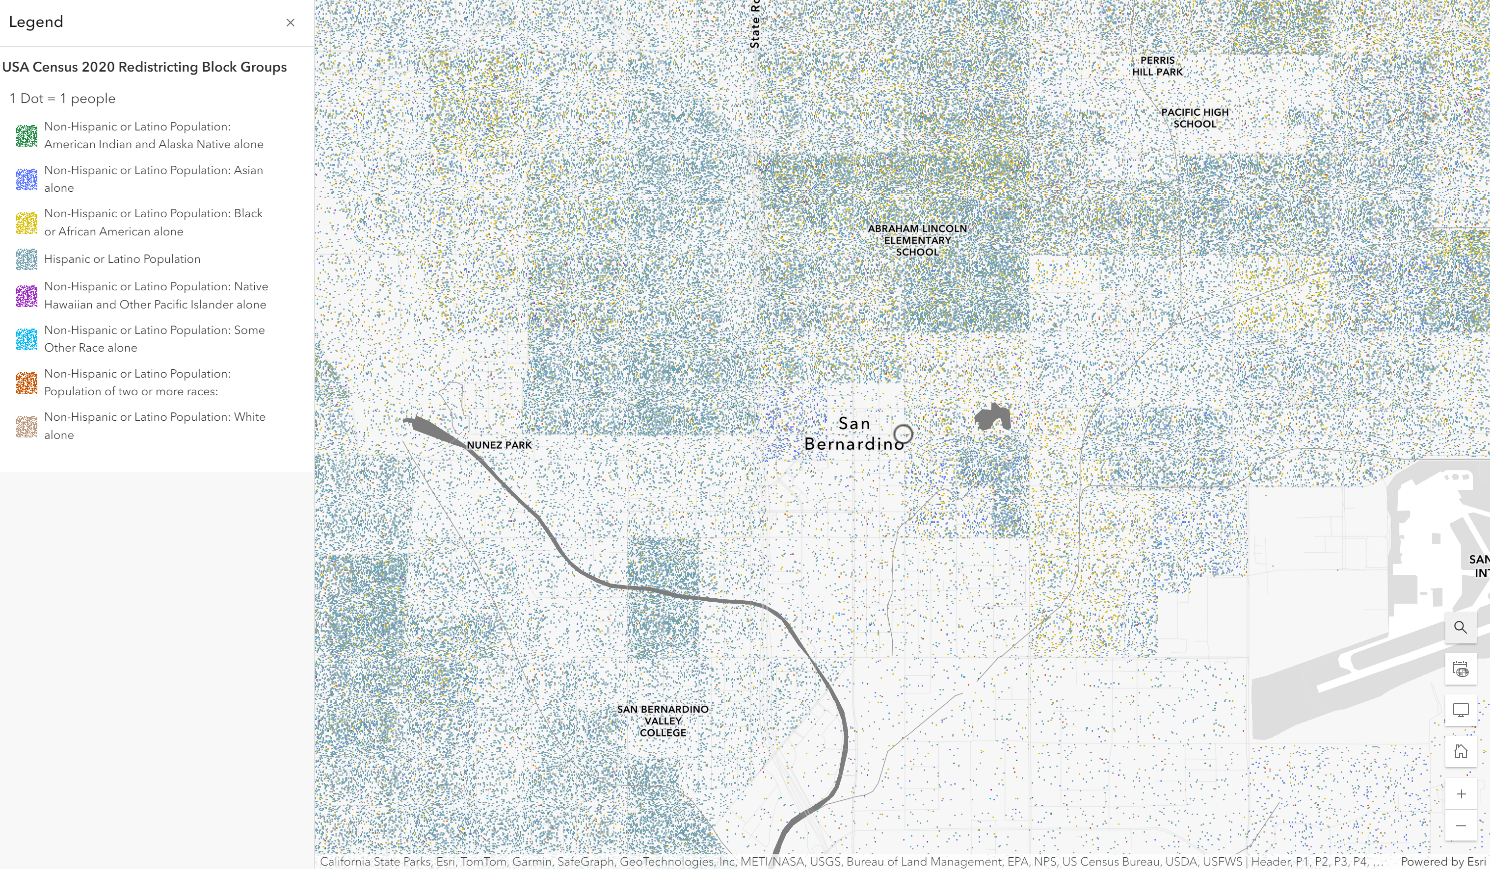
San Bernardino, CA
Notes:
Issues of race became more spatially pronounced – the effects still very present in today’s geography

Slide 10
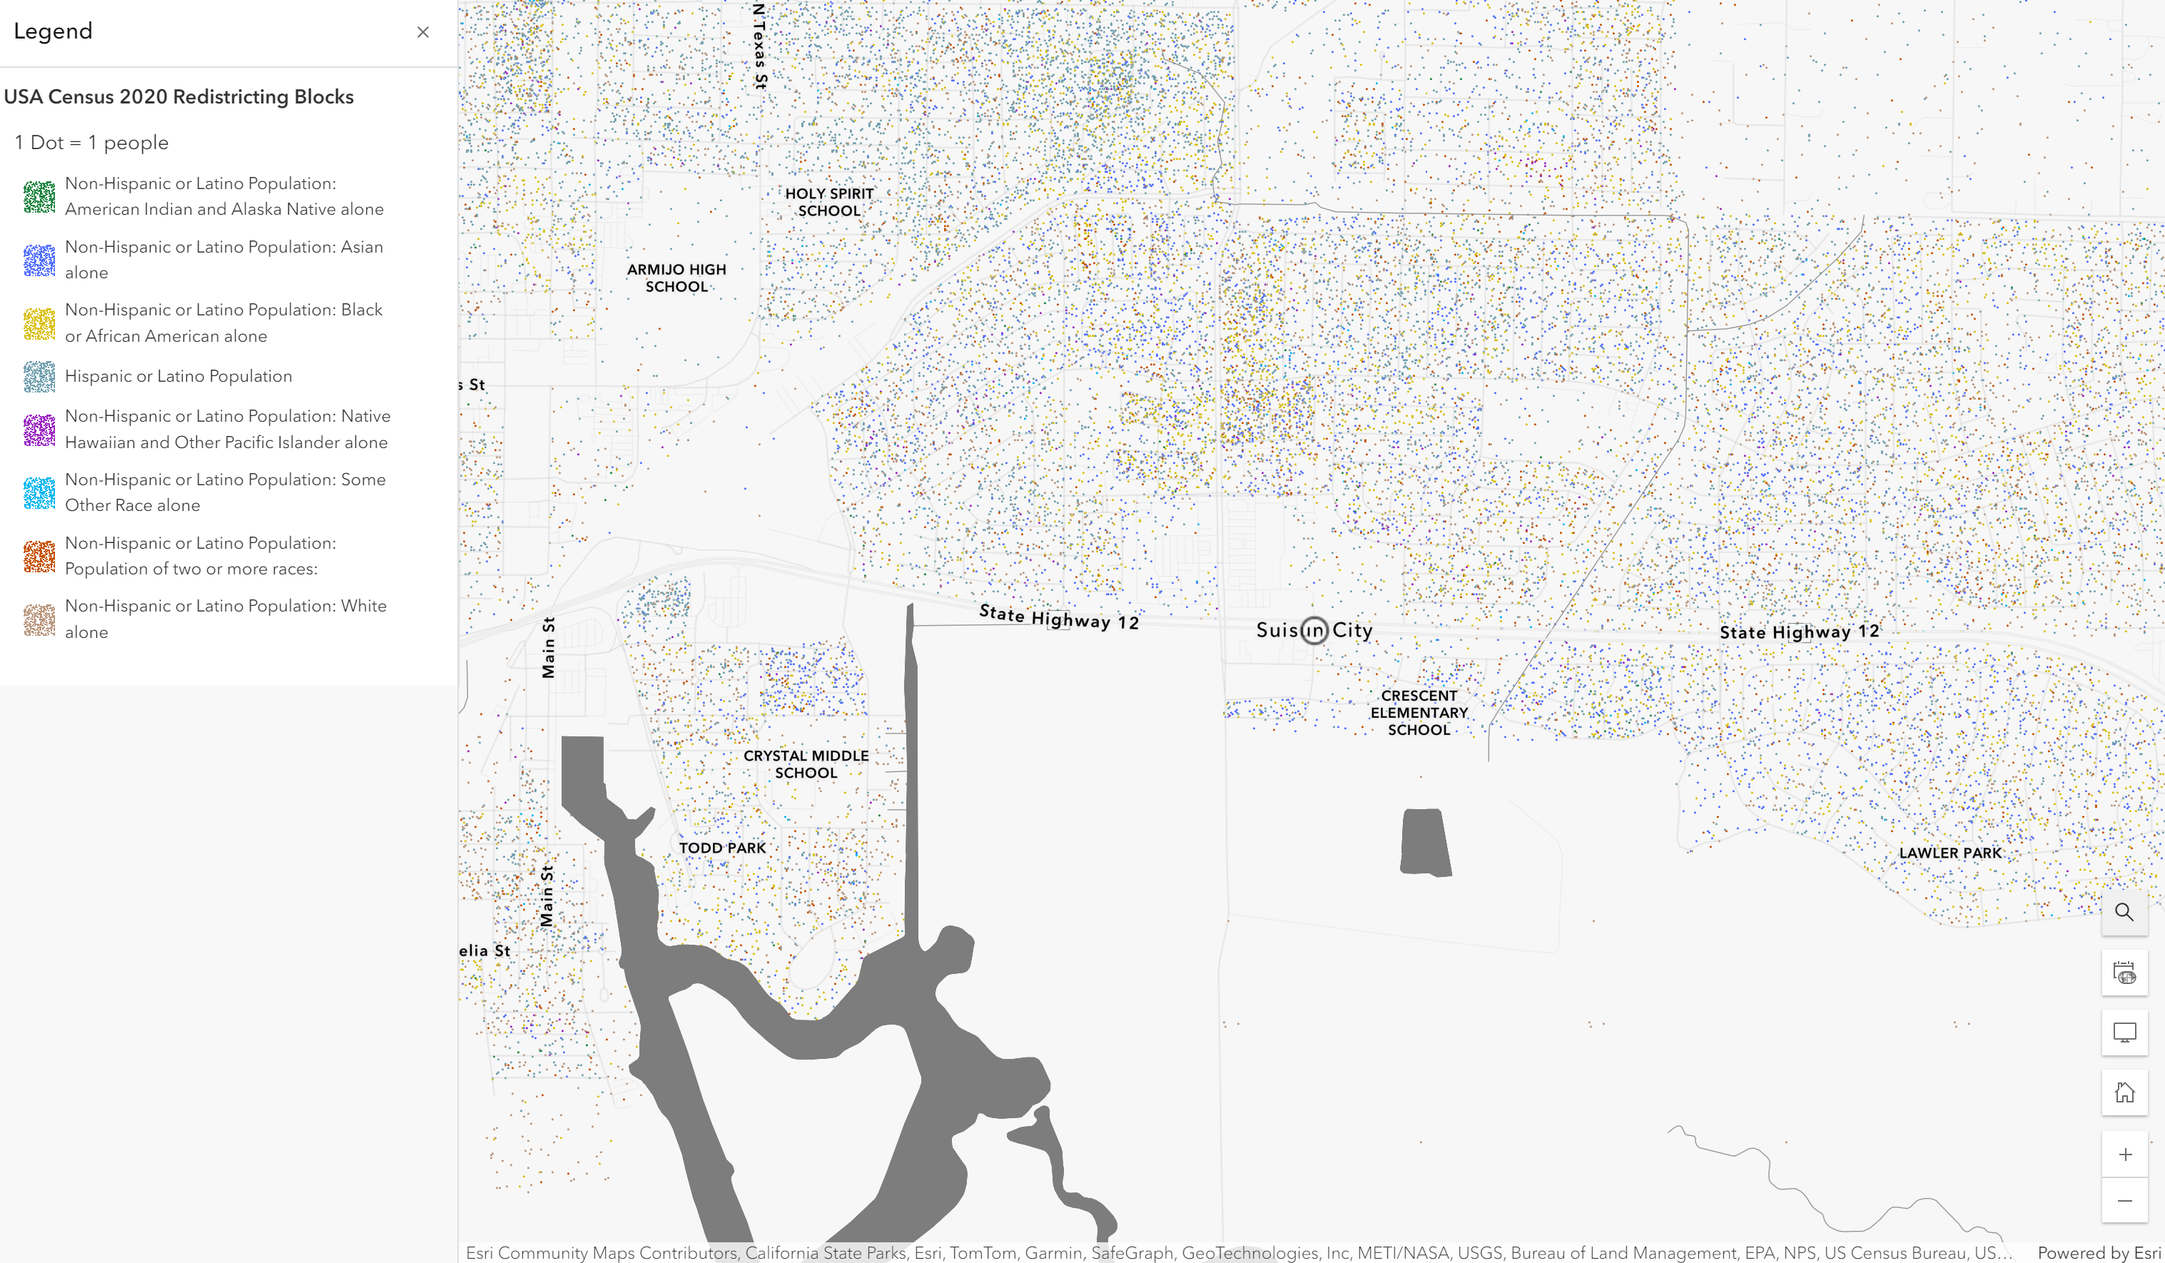
Suisin City, CA
Notes:
Issues of race became more spatially pronounced – the effects still very present in today’s geography

Slide 11
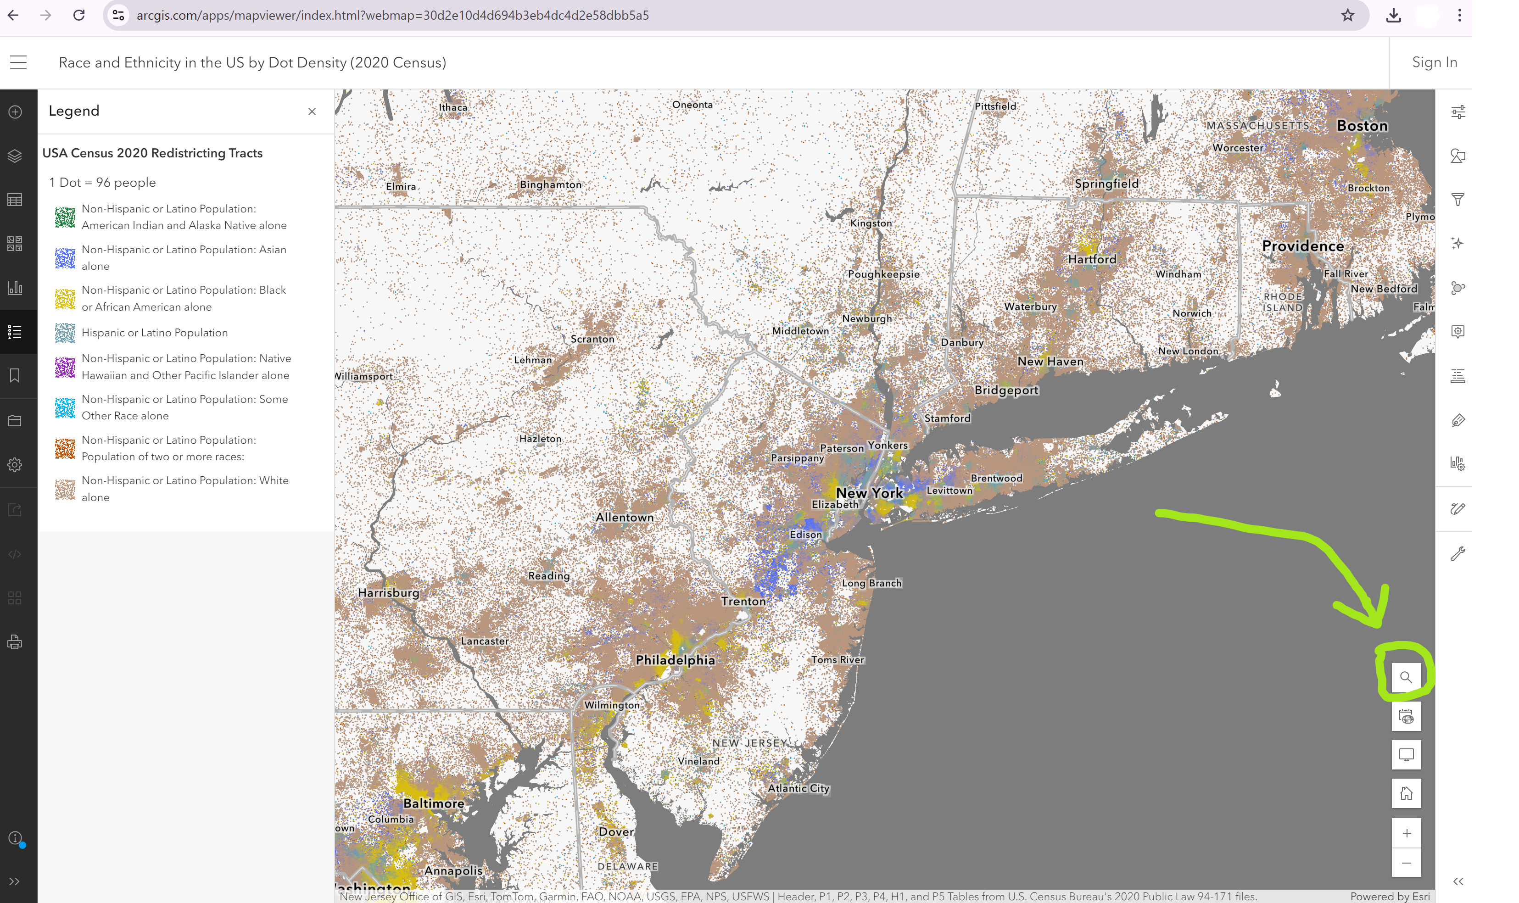
Website:
https://www.arcgis.com/apps/mapviewer/index.html?webmap=30d2e10d4d694b3eb4dc4d2e58dbb5a5
The website automatically opens up to New York, but you can search any city by clicking here
Notes:
Planning theory should address:
What is the relationship between the urban context and outcome?
How does planning affect city users, including residents, commuters and visitors?
What principles should guide plan the formation, content and implementation?

